Slide 1
Young Married Couple
Ray Caldwell

Slide 2
Young Married Couple
This lesson will focus on a tax return for a typical young married couple
The following new tax topics* will be discussed:
  Filing Status: Married Filing Jointly (MFJ), Married Filing Separately (MFS) and Qualifying Widow(er) (QW)
  Dependency: Qualifying Relative
  Income: Dividends, IRA Distribution, Other Income (Prize, Jury Duty), Self-Employment
  Adjustments: Educator Expenses, Jury Duty Repayment
  Credits: Foreign Tax Credit, Education Credit, Credit for Other Dependents
  Miscellaneous: Estimated Tax Payments
* This problem assumes that the Andrews and Baker problems have been completed already.
Tax topics introduced in those problems may appear in Caldwell, but they will not be discussed again

Slide 3
Young Married Couple cont’d
Additional topics/practice on previously introduced forms:
  W-2: Excess Unemployment, Disability, and Family Leave
  1099-INT: Tax-Exempt Interest
  1099-R: Early Distribution Penalty
* This problem assumes that the Andrews and Baker problems have been completed already.
Tax topics introduced in those problems may appear in Caldwell, but they will not be discussed again

Slide 4
Basic Information
Ray Caldwell

Slide 5
Scenario Step 0
Basic Information

Slide 6
Five Choices for Filing Status
Single
Married Filing Jointly (MFJ) – used for Caldwell problem
Married Filing Separately (MFS)
Head Of Household (HOH)
Qualified Widow(er) (QW)

Slide 7
Decision Tree for Determination of Filing Status – Pub 4012 Page B-8
Don’t miss the footnotes
MFJ, MFS
QW

Slide 8
Interview Tips for Determining Filing Status -
Pub 4012 Page B-9
Don’t miss
the footnotes
MFJ
MFS
QW

Slide 9
Married Filing Jointly (MFJ)
Married on last day of year
  Married and living together
  Living apart but not legally separated or divorced
  Separated but divorce decree not final
  Common law marriage does not apply in NJ
Spouse died during current year/not remarried
Generally, most advantageous filing status

Slide 10
Married Filing Separately (MFS)
Why file MFS?
  Taxpayer chooses to file MFS
  Spouse has already filed MFS
  Married but separated and not filing MFJ
    Cannot file Single even if separated for years and does not know spouse’s location
Must provide spouse’s Social Security #
  If not known, file paper return
  Required field in TSO so enter 111-00-1111

Slide 11
MFS - Disadvantages
Highest tax rate/lower standard deduction
Maximum social security is taxable if lived with spouse at all during the year
Cannot claim most tax credits (EIC, education credits, credit for elderly or disabled)
Cannot deduct student loan interest
Cannot use standard deduction if spouse itemized
  Even if you file first‏

Slide 12
Qualifying Widow(er) (QW)
Spouse died in one of two past years
  Dependent* child and/or stepchild lived in home all year
  Grandchild not eligible
Maintained home (paid >50% of cost) for child
Can file QW for two years only
Advantages
  Standard Deduction – same as MFJ
  Uses MFJ tax rates
* Or would have been a dependent but for gross income, joint return, or taxpayer is a dependent tests

Slide 13
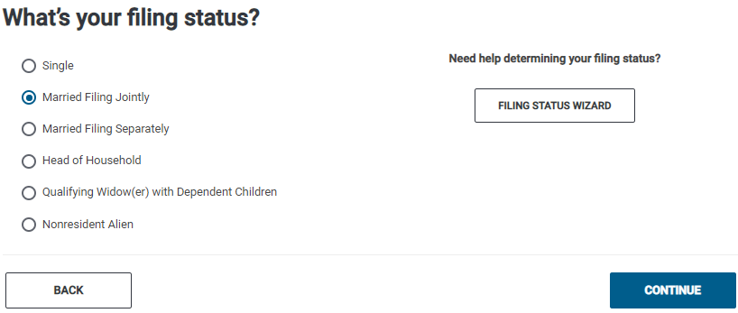
TSO – Entering Filing Status
Basic Information>Filing Status
MFJ filing status

Slide 14
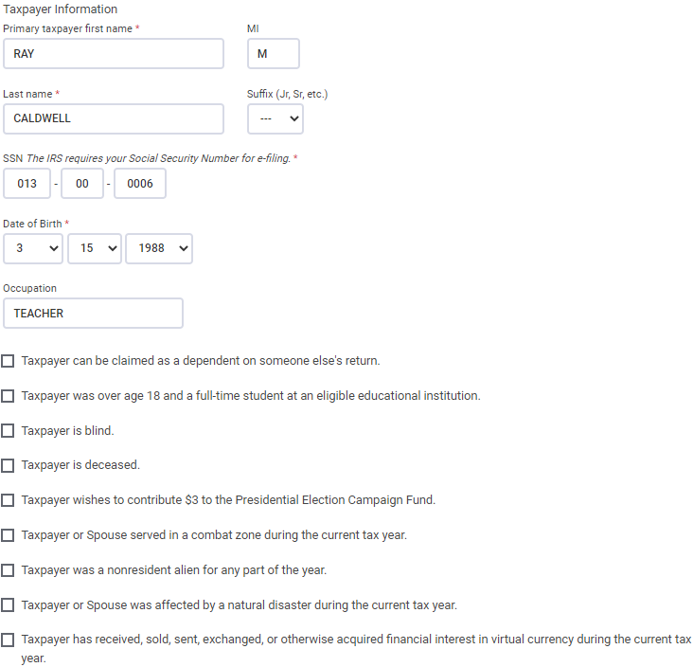
TSO – Entering Personal Information for Ray Caldwell
Basic Information>Personal Information
See Andrews problem
for information on
completing Personal
Info screens

Slide 15
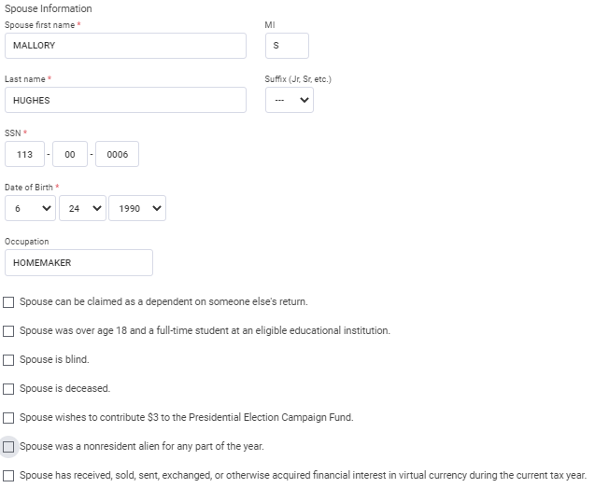
TSO – Entering Personal Information for Mallory Hughes
Basic Information>Personal Information
Name must match SS card, not Intake sheet

Slide 16
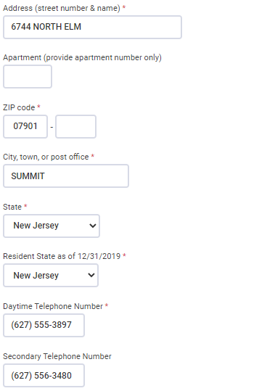
TSO – Entering Personal Information for Taxpayer and Spouse
Basic Information>Personal Information
cont’d

Slide 17
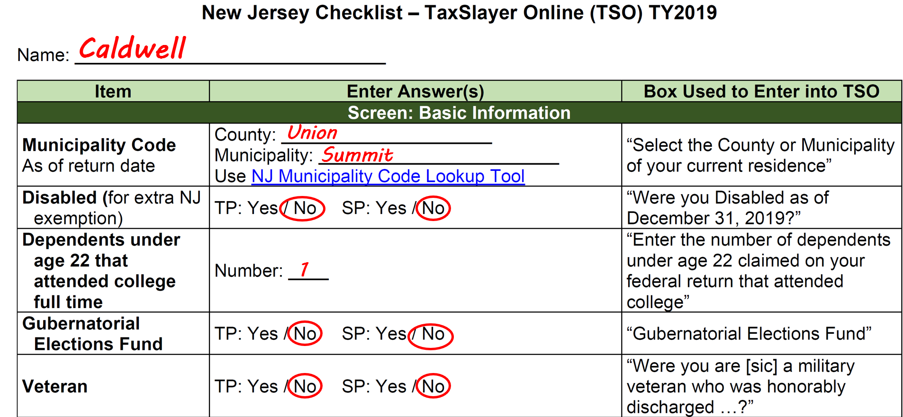
Enter Additional Personal Info on NJ Checklist

Slide 18
TSO - Student Activity
Basic Information>Filing Status and Personal Information
Pause the slide show
In TSO:
  Start the tax return for the Caldwells
  Enter the filing status for the Caldwells
  Enter the Personal Information for Ray and Mallory

Slide 19
Dependent Exemption
Person other than taxpayer or spouse who entitles taxpayer to an exemption:
  Qualifying child (which also includes adult with disability)
  OR
  Qualifying relative (which also includes qualifying non-relatives)
Qualifying Child was discussed in Baker;
Qualifying Relative will be discussed here

Slide 20
Tests to be a Qualifying Relative – Pub 4012
Page C-1
Be sure to read the
footnotes
Qualifying child test
Relationship/member of household test
Gross income test
Support test

Slide 21
Other Dependency Charts/Tools
You may also have to refer to other Dependency Charts in Pub 4012 (see Baker problem for more details)
  Children of divorced or separated parents – Page C-6
  Qualifying child of more than one person – Page C-2
Can use any of the tools listed in Baker problem to determine if qualifying relative
  Laminated flowchart for Qualifying Child/Qualifying Relative or online version of this flowchart on TP4F
  IRS Interactive Tax Assistant on IRS website
  Bogart Dependent Calculator on TP4F

Slide 22
Dependency and Filing Requirement for Jason Caldwell
Jason meets all the requirements to be claimed as a qualifying child
Jason has $2,000 of earned income and no unearned income
  Does not have to file his own tax return (Pub 4012 Chart B Page A-2)
  Should still file if any taxes were withheld
Jason lived at home for only 4 months; resided at college for 8 months
  College is considered temporary absence, so enter 12 months in TSO as number of months lived in home
  Temporary absences also include illness, business, vacation, military service, incarceration, and institutionalized care for a child who is permanently and totally disabled

Slide 23
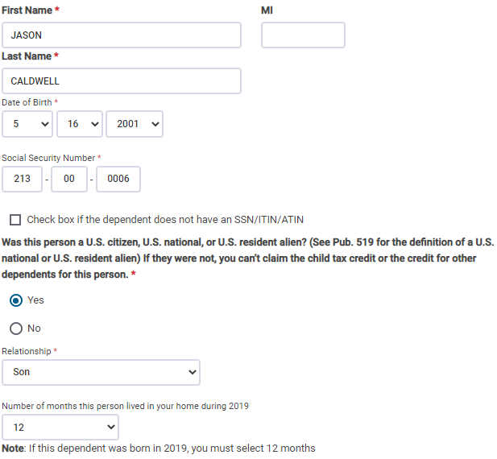
TSO – Entering Dependent Information
Basic Information>Dependents/Qualifying Persons
Jason lived at college for 8 months; considered temporary absence
so enter 12 months in TSO

Slide 24
Dependency and Filing Requirement for Nancy Hughes
Nancy meets all the requirements to be claimed as a qualifying relative
  Nancy is Mallory’s mother; parent is not required to live with taxpayer, but she did live with them for 11 months (Pub 4012 Page C-4 Step 2)
  Had less than $4,200 in gross income (Pub 4012 Page C-4 Step 4)
  Caldwells paid more than half of Nancy’s total support (Pub 4012 Page C-5 Step 5)
Nancy has $2,500 of unearned income from a traditional IRA withdrawal and no earned income
  Nancy has to file her own tax return since her unearned income > $ 1,100 (Pub 4012 Chart B Page A-2)
  On Nancy’s return, she will check box on Personal Information screen to say that Caldwells can claim her as a dependent

Slide 25
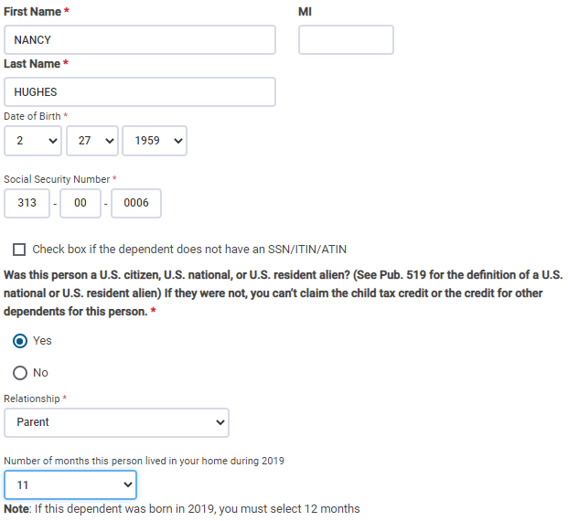
TSO – Entering Dependent Information
Basic Information>Dependents/Qualifying Persons
TSO populates based on taxpayer’s last name; Correct to Hughes
Relationship to taxpayer
Enter 11 months

Slide 26
TSO - Student Activity
Basic Information>Dependents/Qualifying Persons
Pause the slide show
Enter the information for Jason and Nancy Hughes on 2 separate Dependent screens in TSO

Slide 27
Income
Ray Caldwell

Slide 28
Scenario Step 1
W-2 Carson County School District

Slide 29
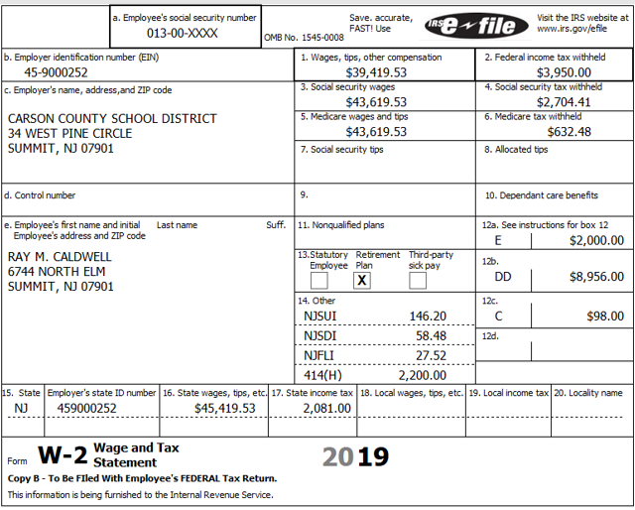
Form W-2 for Carson County School District
Differences between Box 1
and Box 3/5 wages
Differences between Federal
and NJ wages
Box 12 codes: E, DD, C
Box 14: 414(H) pension

Slide 30
Information on Carson County School District W-2 Not on Previous W-2s
See Andrews and Baker problems for previously covered W-2 info
Difference between Box 1 wages and Boxes 3/5 wages
  $2,000 due to contribution to 403b, shown in Box 12a with code E
    403b – retirement plan for employees of public schools, tax-exempt organizations, and certain ministers
    Pre-tax contribution, so amount not included in Box 1 taxable wages, but is included in Social Security and Medicare wages
  $2,200 due to contribution to 414h pension, shown in Box 14
    Pre-tax contribution, so amount not included in Box 1 taxable wages, but is included in Social Security and Medicare wages
    414h contribution is not considered a voluntary contribution so does not qualify for Retirement Savings Credit on Form 8880
    Choose “Retirement (Not in Box 12) – Do not carry to Form 8880” from drop-down menu

Slide 31
Information on Carson County School District W-2 Not on Previous W-2s
cont’d
Box 12 codes
  E: Contribution to a 403b plan
  DD: Cost of employer-sponsored health coverage (information only; does not impact taxes but must be entered into TSO)
  C: Taxable costs of group term life insurance > $50,000
    First $50,000 of group term life insurance taxpayer coverage provided by employer is excluded from tax
    Cost of coverage in excess of $50,000 must be included as income in Box 1, 3, and 5 wages
Box 14 code
  Contribution to 414h pension

Slide 32
Information on Carson County School District W-2 Not on Previous W-2s
cont’d
Difference between Federal wages (Box 1) and NJ wages (Box 16)
  Refer to NJ Special Handling document
  To identify differences, look in Boxes 12 and 14. Also look on W-2 supplement or taxpayer year-end pay stub
  Certain items are pre-tax for Federal (not included in Box 1 wages), but after-tax for NJ (included in Box 16 wages)
    $2,000 for contribution to 403b
    $2,200 for contribution to 414h pension
    $1,500 for health insurance premiums payroll deductions under Cafeteria Plan (Sec 125), shown as supplemental information

Slide 33
Information on Carson County School District W-2 Not on Previous W-2s
cont’d
Difference between Federal wages (Box 1) and NJ wages (Box 16) – cont’d
      Since after-tax for NJ and thus no tax benefit, can claim premiums as medical expenses on NJ 1040
      Note premiums on NJ Checklist in Subtractions from Income section under “W-2 pre-tax medical premiums”
    $300 for life insurance premiums payroll deductions under Cafeteria Plan (Sec 125), shown as supplemental information

Slide 34
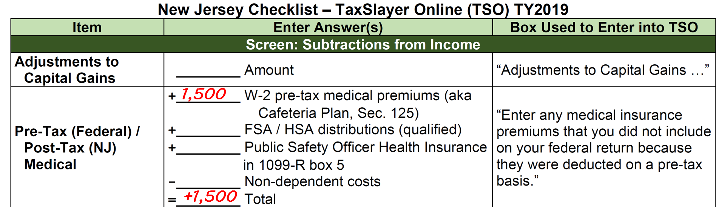
Pre-Tax (Federal)/Post-Tax (NJ) Medical on NJ Checklist
Health insurance premiums under Cafeteria Plan (Sec 125)

Slide 35
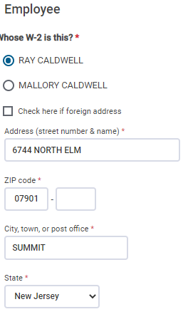
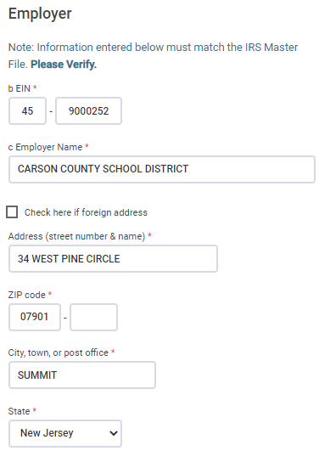
TSO - Entering W-2
Federal Section>Income>W-2
Employee
Information
Employer
Information
Click on whose
W-2

Slide 36
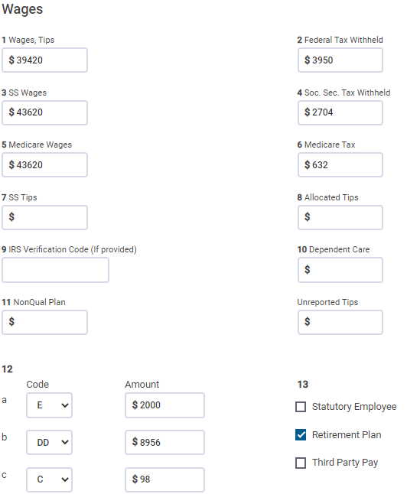
TSO - Entering W-2
Federal Section>Income>W-2
cont’d
TSO populates Boxes 3 and 5 based
on Box 1; Correct to match printed
W-2; TSO recalculates Boxes
4 and 6
Choose codes E, DD, and C from drop-down menu
C

Slide 37
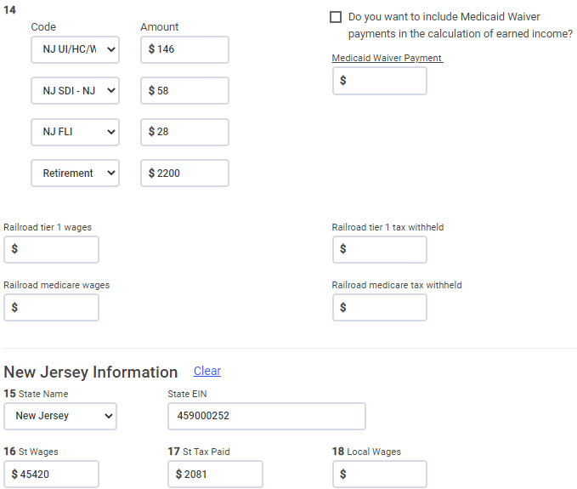
TSO - Entering W-2
Federal Section>Income>W-2
cont’d
Choose “Retirement (Not in
Box 12) – Do not carry to Form 8880” from drop-
down menu for 414h
TSO transfers from Box 1;
Correct to match printed
W-2

Slide 38
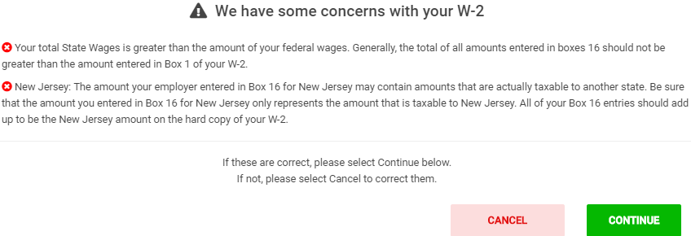
TSO - Warning Messages Regarding W-2

Slide 39
TSO - Student Activity
Federal Section>Income>W-2
Pause the slide show
Enter the Carson County School District W-2 into TSO (Step 1)
Check the Federal and NJ refund monitors

Slide 40
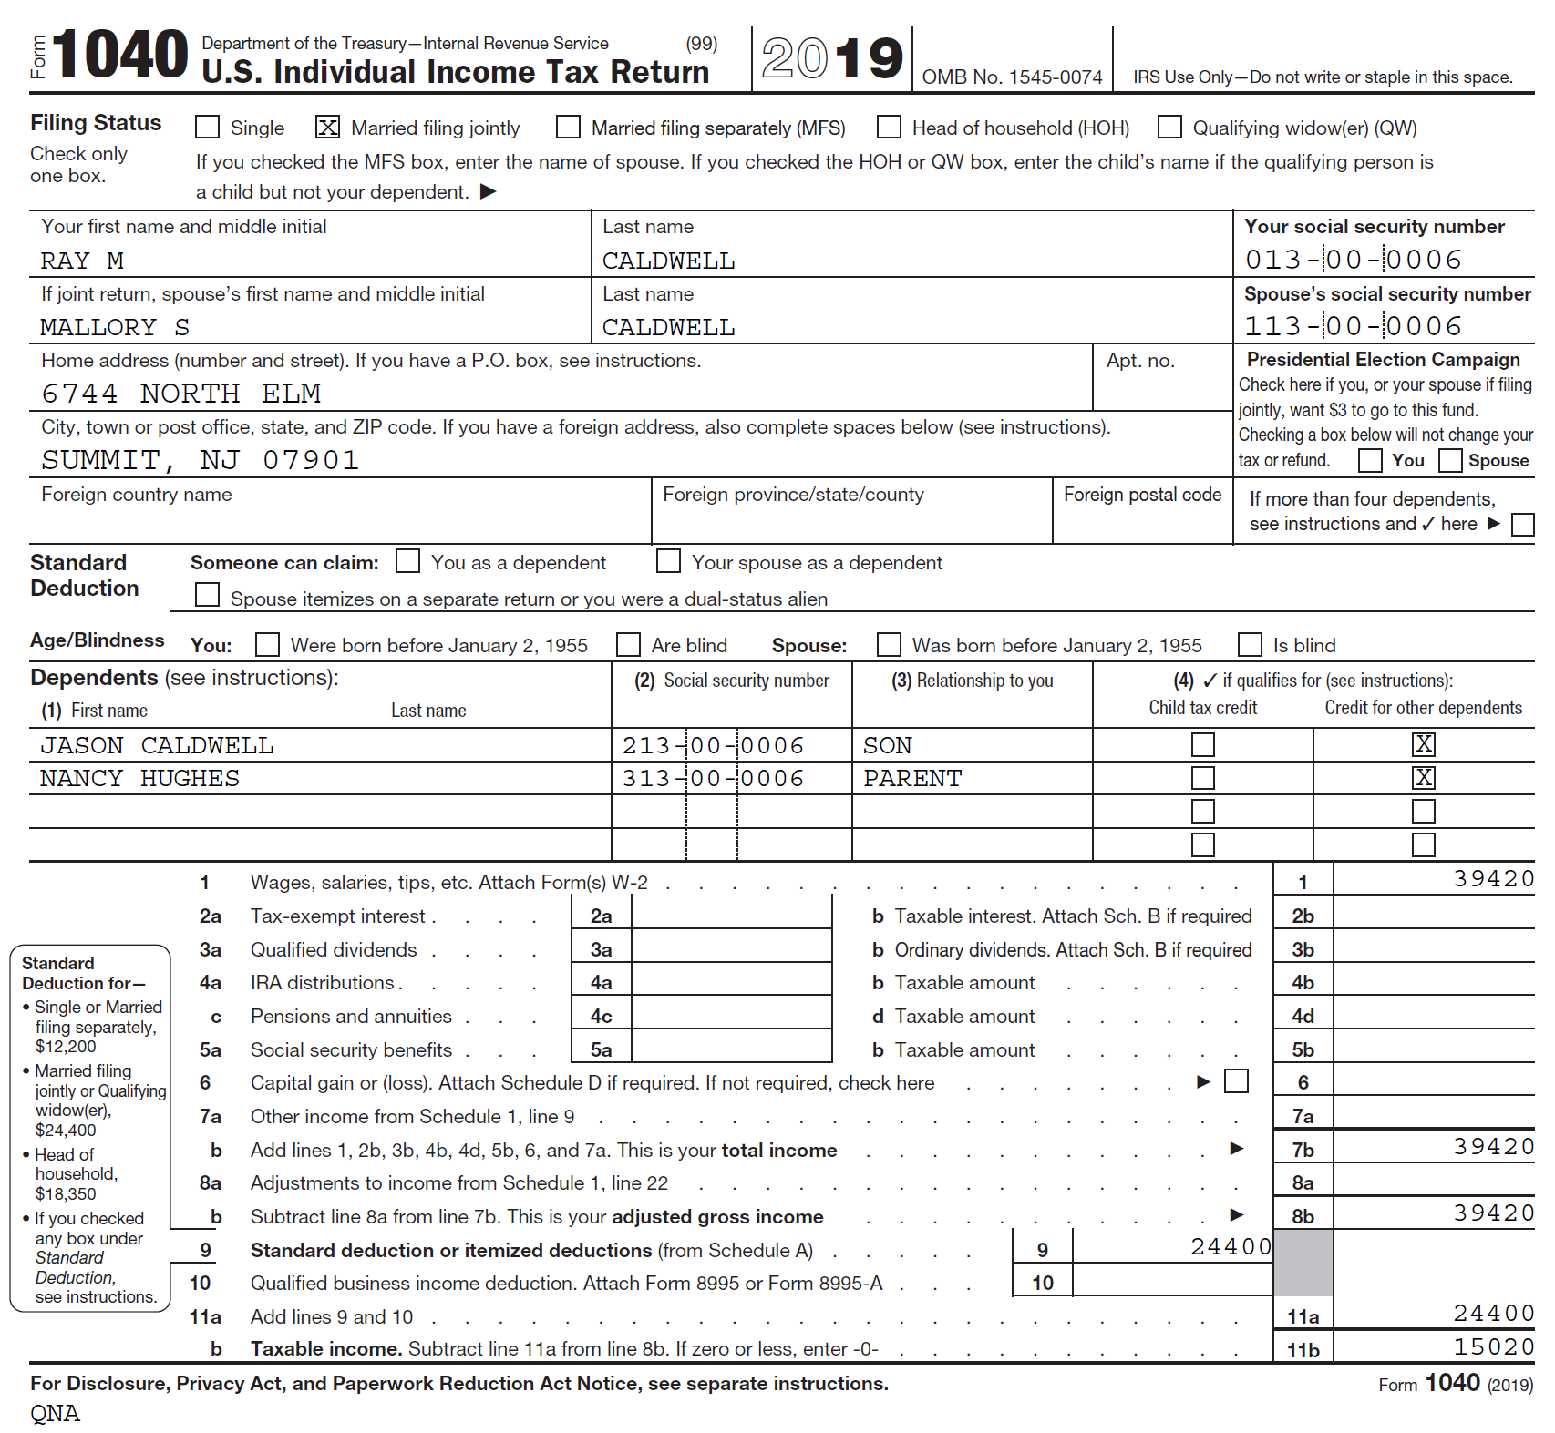
TSO - Wages on Federal 1040
Transferred from W-2
Box 1

Slide 41
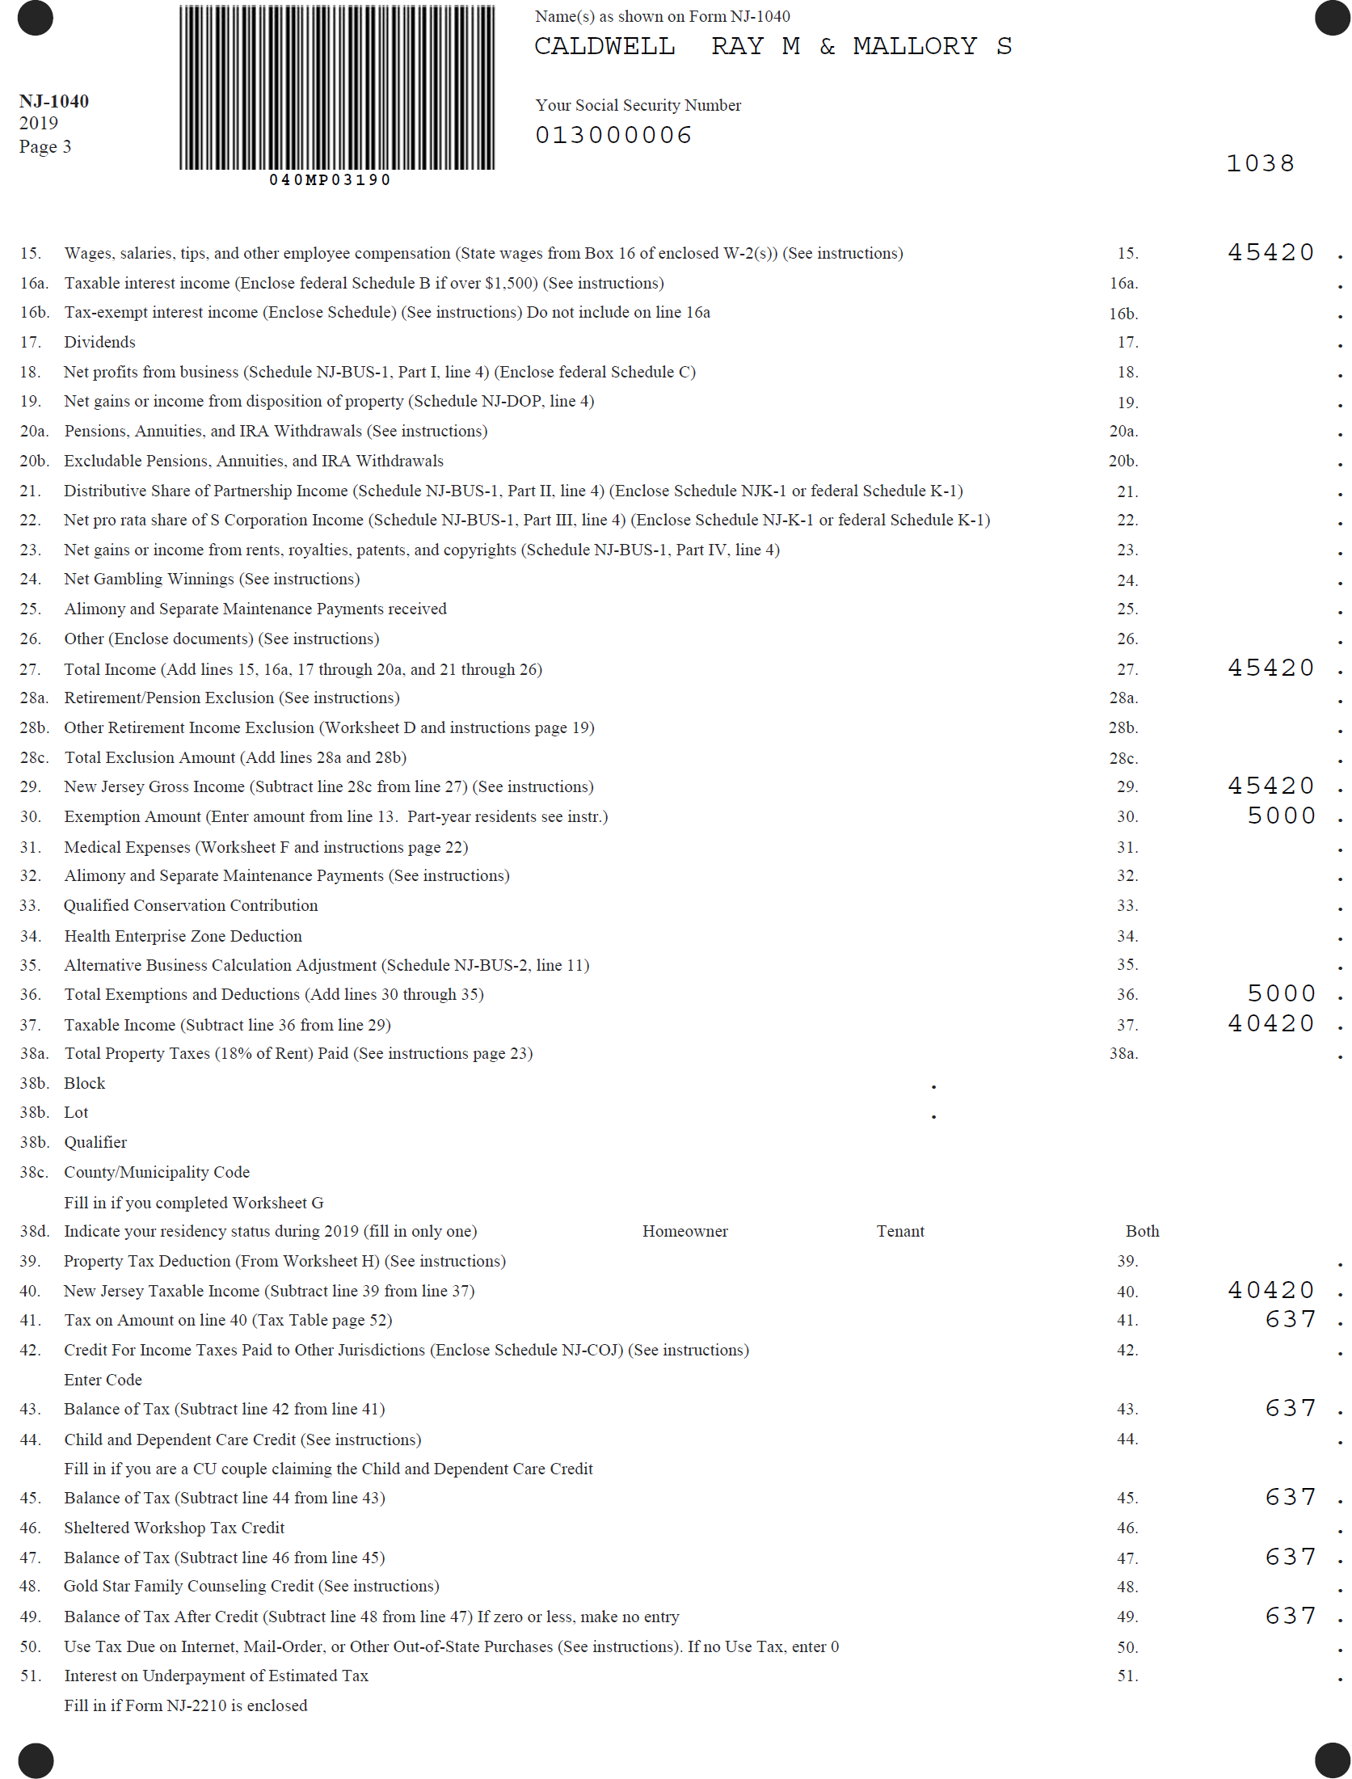
TSO - Wages on NJ 1040
Transferred from W-2
Box 16

Slide 42
Scenario Step 2
W-2 Second Street Bar

Slide 43
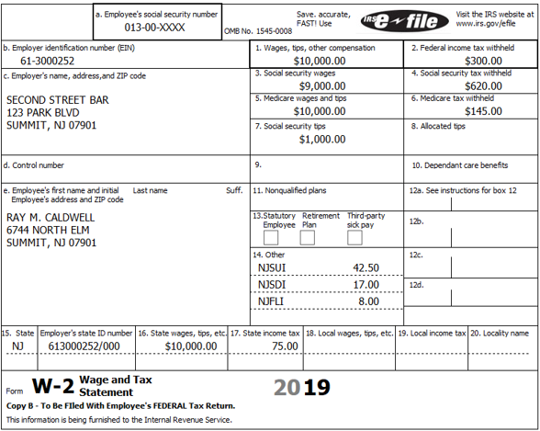
Form W-2 for Second Street Bar
Social Security tips

Slide 44
Tip Income
Social Security tips – reported in Box 7
  Employee must report tips collected to employer (other than months with less than $20)
  Employer reports those on W-2 as Social Security tips (Box 7)
  Employer withholds Social Security and Medicare taxes (Boxes 4 and 6)
Allocated tips – reported in Box 8
  Employer legally must also account for estimated unreported tips
    Calculated from the difference between the reported tips and a percentage of food & drink sales
    Difference allocated between all employees
  Each employee’s share of allocated tips reported in Box 8

Slide 45
Tip Income cont’d
Employee must declare unreported tips as income on W-2 screen
  Enter in W-2 box under Box 10 called Unreported Tips
Employee must pay Social Security and Medicare Taxes on allocated tips and any unreported tips
  TSO generates Form 4137 to calculate taxes due
    Allocated tip and unreported tips automatically transferred from W-2 screen to Form 4137
    Social Security and Medicare taxes due reported on Schedule 2 Line 5
All tips included in Wages line on Federal and NJ 1040s

Slide 46
Tips Entered in TSO
Box 3 (SS Wages) + Box 7 (SS Tips) = Box 1 (Total Wages)
TSO populates Boxes 3 and 5 based on Box 1 wages
  Correct Box 3 (SS Wages) to match printed W-2
  TSO recalculates Box 4 (SS Tax Withheld) based on new value in Box 3
  However, employer withheld SS taxes on both SS wages + SS tips. Must correct recalculated Box 4

Slide 47
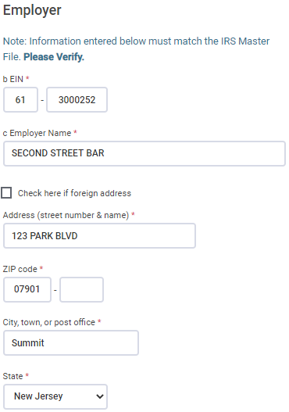
TSO - Entering W-2 for Second Street Bar
Federal Section>Income>W-2
Employee
Information
Employer
Information
Click on whose
W-2

Slide 48
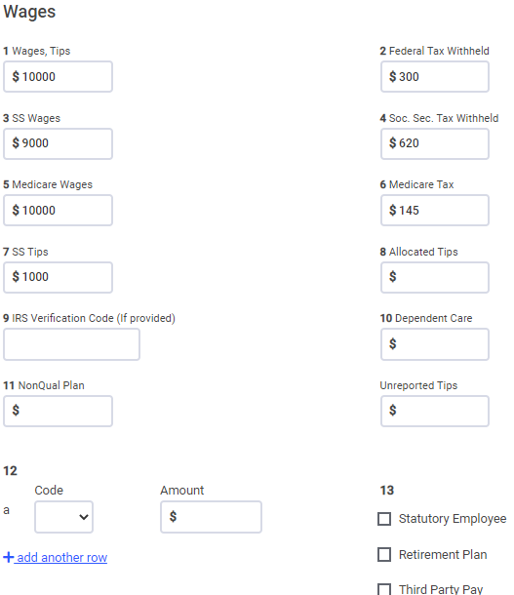
TSO - Entering W-2 for Second Street Bar
Federal Section>Income>W-2
cont’d
Box 3 + Box 7 = Box 1
Correct Boxes 3 and 4 to match printed W-2
Social Security tips
C

Slide 49
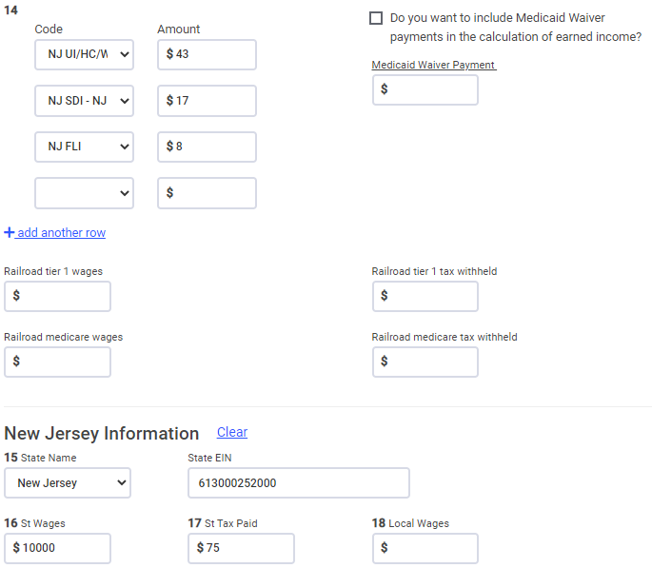
TSO - Entering W-2 for Second Street Bar
Federal Section>Income>W-2
cont’d

Slide 50
Excess Unemployment (UI), Disability (DI) and Family Leave Withholdings (FLI)
One employer
  If withholdings for UI, DI, or FLI exceed the maximums, taxpayer must deal with employer to rectify
Two or more employers
  If total withholdings for all employers exceed the maximums, taxpayer can claim excess amounts as a refundable credit on NJ return
    TSO calculates excess amounts on NJ Form 2450
    Credits are reported on NJ 1040 Lines 58 - 60

Slide 51
TSO - Student Activity
Federal Section>Income>W-2
Pause the slide show
Enter the Second Street Bar W-2 into TSO (Step 2)
Check the Federal and NJ refund monitors

Slide 52
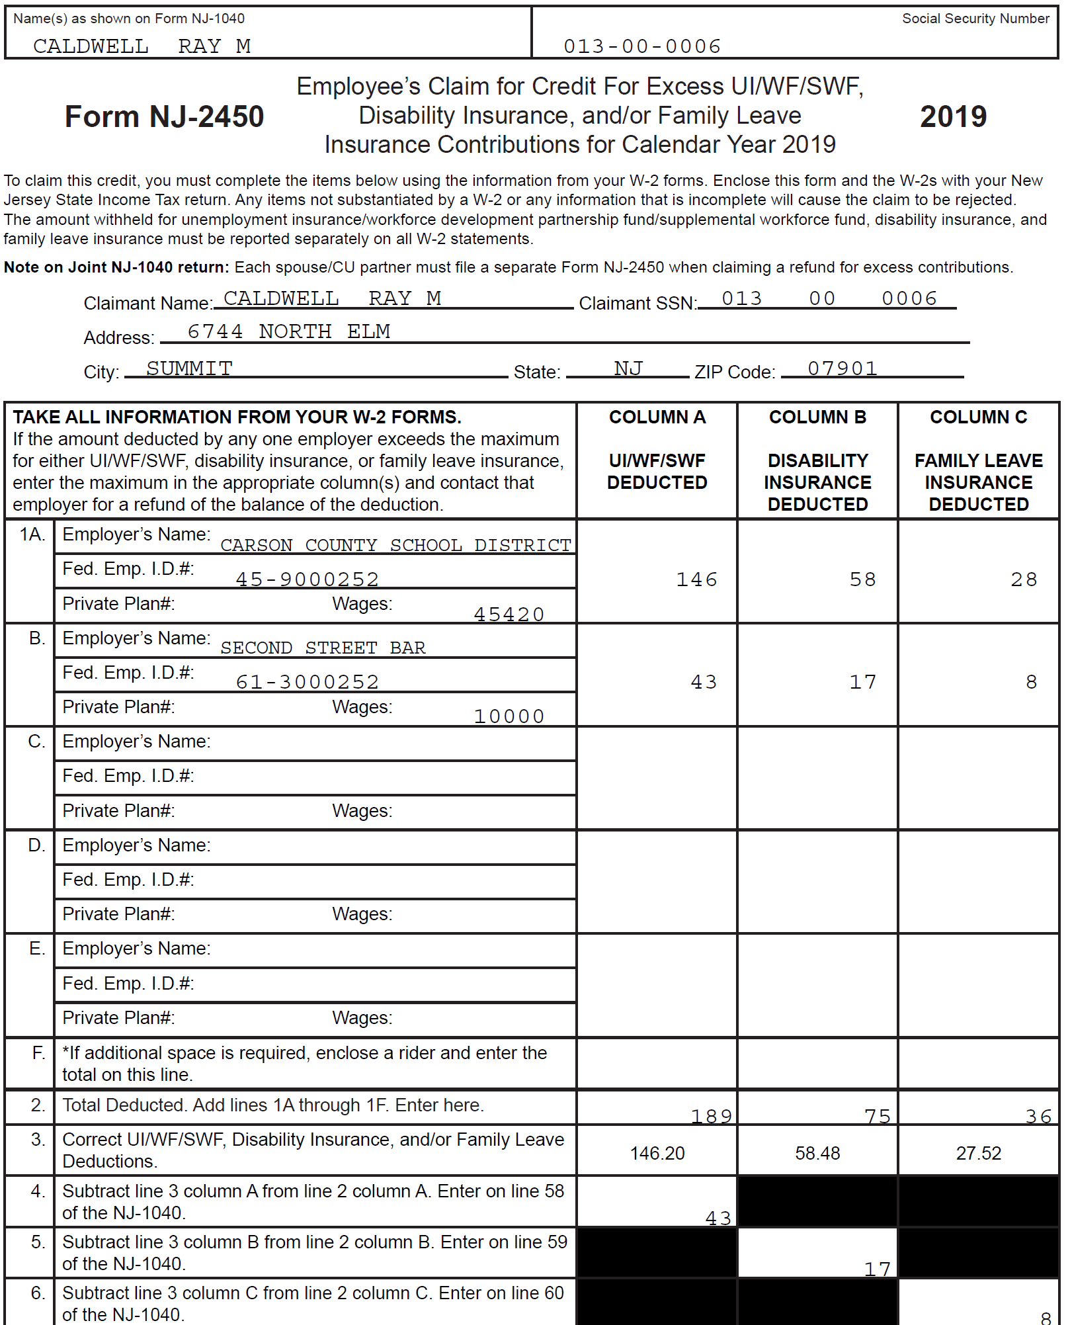
TSO – Calculating Excess UI, DI, and FLI on NJ Form 2450
Totals withheld from both jobs
Maximum annual limits
Excess UI, DI, FLI

Slide 53
TSO - Credits for Excess UI, DI, and FLI Withholdings on NJ 1040
Credits for excess UI, DI, FLI

Slide 54
Scenario Step 3
Interest Acme Financial Corporation

Slide 55
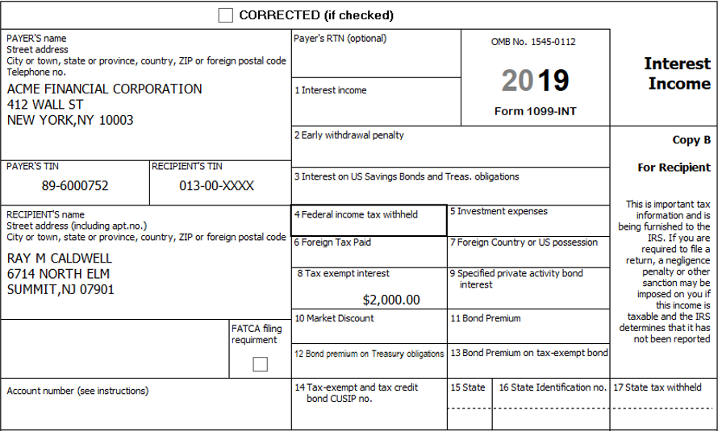
Tax-Exempt Interest on 1099-INT
Federal tax-exempt interest

Slide 56
Tax-Exempt Interest
Refer to Pub 4012 Page D-9
Tax-exempt interest (Box 8)
  Interest on obligations issued by states, municipalities, Washington D.C, and U.S. territories/possessions is tax-exempt on Federal return
  Federal tax-exempt interest may or may not be taxable on NJ return
    Refer to NJ Special Handling document
    Refer to NJ GIT-5 Exempt Obligations
      Can be accessed through NJ Gross Income Tax Publications link on TP4F Preparer page

Slide 57
Tax-Exempt Interest
cont’d
    Interest on NJ obligations is not taxable
    Interest on obligations from other states is taxable
  TSO transfers Box 8 interest to NJ return as tax-exempt
    Must specifically tell TSO to add interest for other states’ obligations to NJ taxable interest

Slide 58
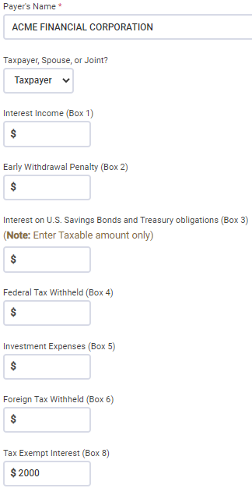
TSO – Entering 1099-INT
Federal Section>Income>1099-DIV,INT,OID>Interest or Dividend Income>Interest Income, Form 1099-INT
Federal tax-exempt income

Slide 59
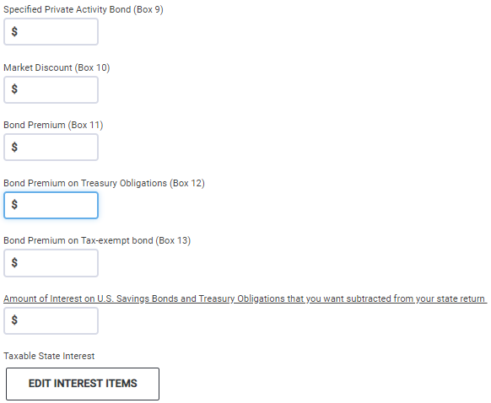
TSO – Entering 1099-INT
Federal Section>Income>Interest and Dividends>Interest or Dividend Income> Interest Income, Form 1099-INT
cont’d
Looking at supplemental detail, only
$200 interest on NJ bond is tax-exempt
on NJ 1040
Click to add interest on other states’
obligations to NJ taxable interest

Slide 60
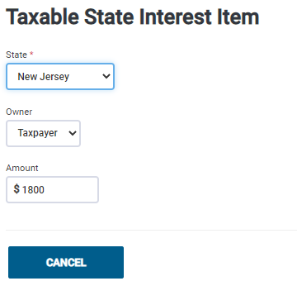
TSO – Taxable Interest on Other States’ Obligations Federal Section>Income>Interest and Dividends>Interest or Dividend Income> Interest Income, Form 1099-INT>Taxable State Interest Item
Add NJ taxable interest for California ($800) + Arizona ($1,000) bonds

Slide 61
TSO - Student Activity
Federal Section>Income>Interest and Dividends>Interest or Dividend Income> Interest Income, Form 1099-INT
Pause the slide show
Enter the Acme Financial Corporation Interest into TSO (Step 3)
Check the Federal and NJ refund monitors

Slide 62
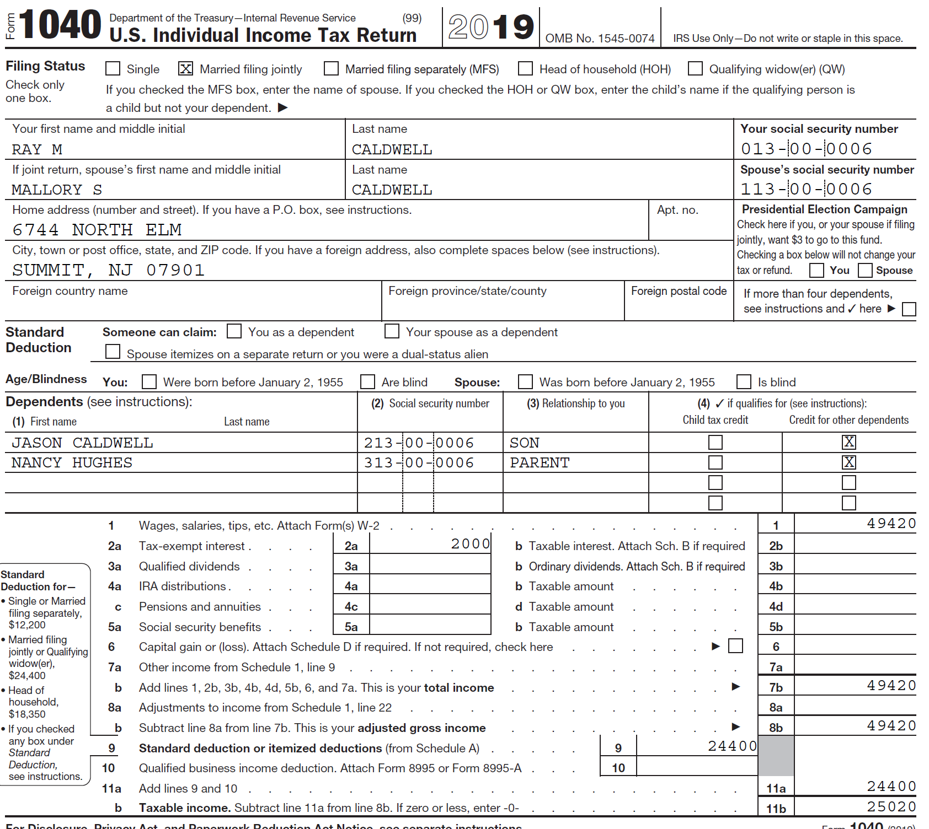
TSO – Tax-Exempt Interest on Federal 1040
Transferred from 1099-INT
Box 8

Slide 63
TSO – Taxable and Tax-Exempt Interest on NJ 1040
NJ taxable interest on California + Arizona bonds
NJ tax-exempt interest on NJ bond

Slide 64
Scenario Step 4
Dividends Ace Financial Corp

Slide 65
Income: Dividends
Dividends are reported on:
  Form 1099-DIV
  Form 1099-DIV on brokerage or mutual fund statement
  Schedule K-1 (later lesson)

Slide 66
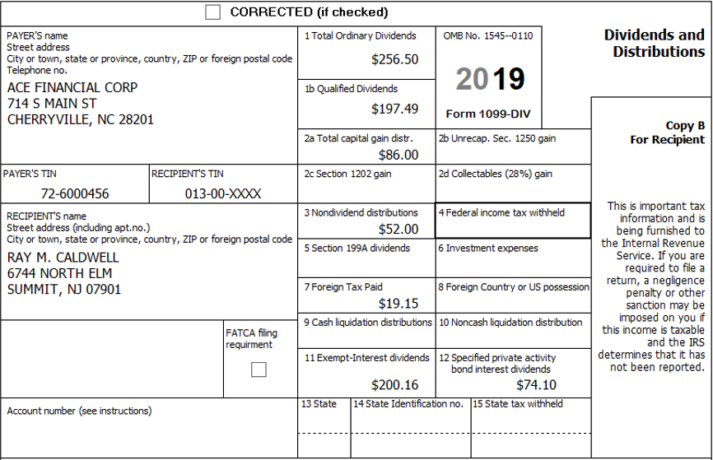
Dividends on 1099-DIV
Ordinary dividends
Qualified dividends
Capital gains distributions
Nondividend distributions
Section 199A dividends
Foreign tax paid
Exempt-interest dividends
Specified private activity bond
interest dividends

Slide 67
Dividends
Ordinary dividends (Box 1)
  Taxed at regular income tax rates
Qualified dividends (Box 1b)
  A subset of ordinary dividends
  Taxed at capital gain rates
Capital gains distribution (Box 2a)
  Payments shareholders receive when a fund sells its holdings at a profit and must, by law, pass the profits along to shareholders
    Not related to whether taxpayer sells shares at a profit (capital gains)
  TSO automatically transfers to Schedule D Capital Gains and Losses if there are other capital gains transactions
    If there are no other capital gains transactions, TSO will transfer directly to 1040 capital gain line

Slide 68
Dividends cont’d
Nondividend distributions (Box 3)
  Return of cost basis
  Not taxed until all cost is recovered
    Still entered into TSO
  When investment is sold, cost basis is reduced by the amount of nondividend distributions received
Foreign tax paid (Box 7)
  Only in scope if less than $300 ($600 MFJ)
  TSO automatically transfers to Schedule 3, Part I as a nonrefundable credit

Slide 69
Dividends cont’d
Specified private activity bond interest dividends (Box 12)
  Private activity bond interest is tax-exempt for regular tax purposes, but is taxable for Alternative Minimum Tax (AMT) purposes
  TSO automatically transfers to Form 6251 as an adjustment to income for AMT (next slide)
  If taxpayer is subject to AMT, out of scope

Slide 70
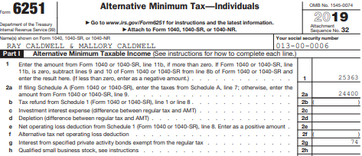
Specified Private Activity Bond Interest Dividends on Form 6251
From 1099-DIV
Box 12
If subject to AMT, out of scope

Slide 71
Dividends cont’d
Exempt-interest dividends (Box 11)
  Tax exempt on Federal return
  Taxability varies for NJ, depending on bonds held by fund (look at statement detail pages)
    Interest attributable to Federal obligations (including Washington D.C., territories, and possessions) always tax exempt
    Interest attributable to other states except NJ always taxable
    Interest attributable to NJ bonds only tax exempt if fund is “NJ Qualified Investment Fund” (usually has NJ in name of fund)
      Interest on NJ bonds held individually by taxpayer (not in a mutual fund) always tax exempt

Slide 72
Taxability of Caldwell Exempt-Interest Dividends for NJ
Dreyfus NJ Tax-Exempt Fund ($50.16) – NJ qualified investment fund
  Federal obligations: 9%-tax exempt
  NJ bonds: 81%-tax exempt
  Bonds from other states: 10%-taxable
Fidelity Municipal Tax-Exempt Fund ($150) – not NJ qualified investment fund
  Federal obligations: 10%-tax exempt
  NJ bonds: 45%-taxable
  Bonds from other states: 45%-taxable
Total for Caldwell: $140 taxable, $60 tax exempt
90% tax exempt = $45
10% taxable = $5
10% tax exempt = $15
90% taxable = $135

Slide 73
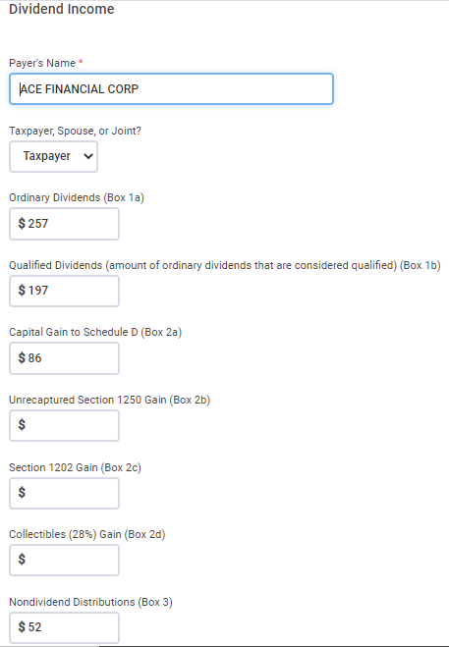

TSO – Entering 1099-DIV
Federal Section>Income>1099-DIV,INT,OID>Interest or Dividend Income>
Dividend Income, Form 1099-DIV
Ordinary dividends
Qualified dividends
Capital gains distributions
Nondividend distributions

Slide 74
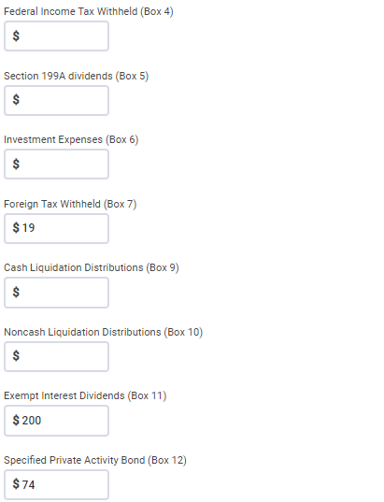
TSO – Entering 1099-DIV
Federal Section>Income>1099-DIV,INT,OID>Interest or Dividend Income>
Dividend Income, Form 1099-DIV
cont’d
Foreign tax paid
Exempt interest dividends
Specified private activity bond interest

Slide 75
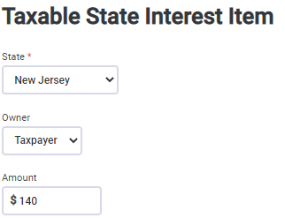

TSO – Entering 1099-DIV
Federal Section>Income>1099-DIV,INT,OID>Interest or Dividend Income>
Dividend Income, Form 1099-DIV>Taxable State Interest Item
cont’d
1099-DIV Screen
Amount of Federal exempt interest dividends
that is taxable for NJ
Reported on NJ Taxable Interest line
(not NJ Dividend line)

Slide 76
TSO - Student Activity
Federal Section>Income>1099-DIV,INT,OID>Interest or Dividend Income> Dividend Income, Form 1099-DIV
Pause the slide show
Enter the Ace Financial Corp Dividends into TSO (Step 4)
Check the Federal and NJ refund monitors

Slide 77
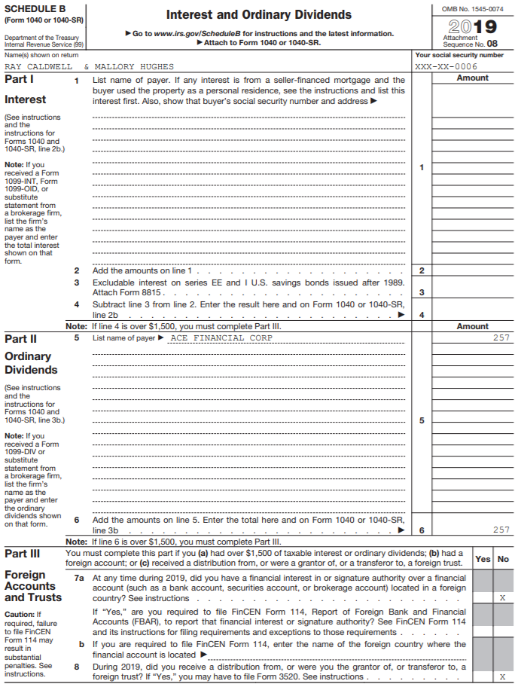
TSO – Dividends on Schedule B

Slide 78
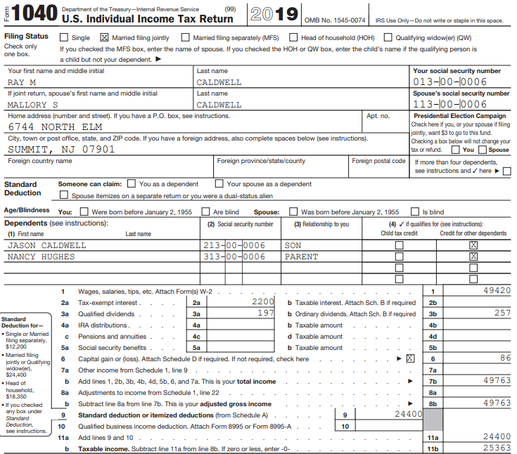
TSO – Dividends and Capital Gains Distributions on Federal 1040
Ordinary dividends
transferred from 1099-DIV
Box 1
Qualified dividends
transferred from 1099-DIV
Box 1b
Capital gains distributions

Slide 79
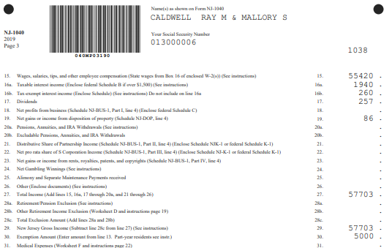
TSO – Dividends, Taxable Interest, and Capital Gains Distributions on NJ 1040
NJ taxable interest:
$1800 from Step 3 +
$140 NJ taxable part of exempt-
interest dividends from 1099-DIV
Box 11
Dividends
from 1099-DIV
Box 1
NJ tax-exempt interest:
$200 from Step 3 +
$60 NJ tax-exempt part of
exempt-interest dividends from
1099-DIV Box 11
Capital gains distributions

Slide 80
Scenario Step 5
IRA Distribution

Slide 81
1099-R Box 7 Codes
Review Pub 4012 Page D-39 for 1099-R distribution codes
Most commonly seen:
  1 – Early Distribution – for Caldwell
  3 – Disability
  4 – Death
  7 – Normal Distribution
  G - Rollover
Always check the Tax-Aide Scope Manual if unsure whether 1099-R is in scope

Slide 82
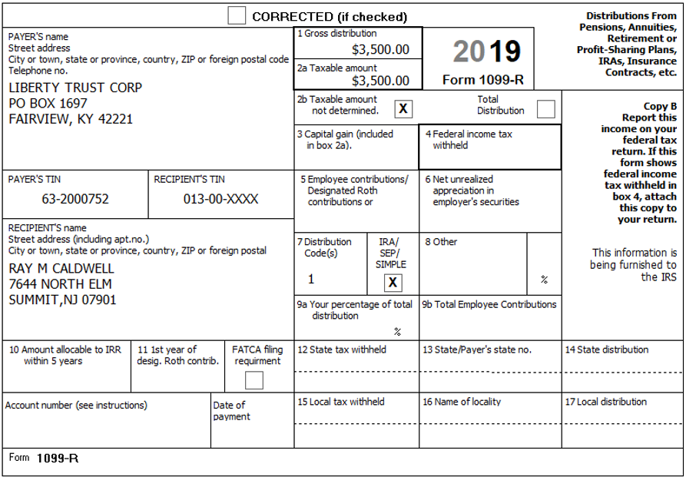
IRA Distribution on 1099-R
Gross distribution
Taxable amount
Code 1 =
early distribution
IRA

Slide 83
Early Distribution from IRA
If money withdrawn from IRA prior to age 59 ½, taxpayer must pay 10% penalty in addition to normal income taxes on distribution
There are certain exceptions to the early withdrawal penalty
  Code 2 early distribution, exception applies
    TSO automatically does not charge a penalty
  Code 1 early distribution, no known exception
    Counselor must determine if exception applies by probing reason for withdrawal with taxpayer
    Must manually apply for exception on Form 5329

Slide 84
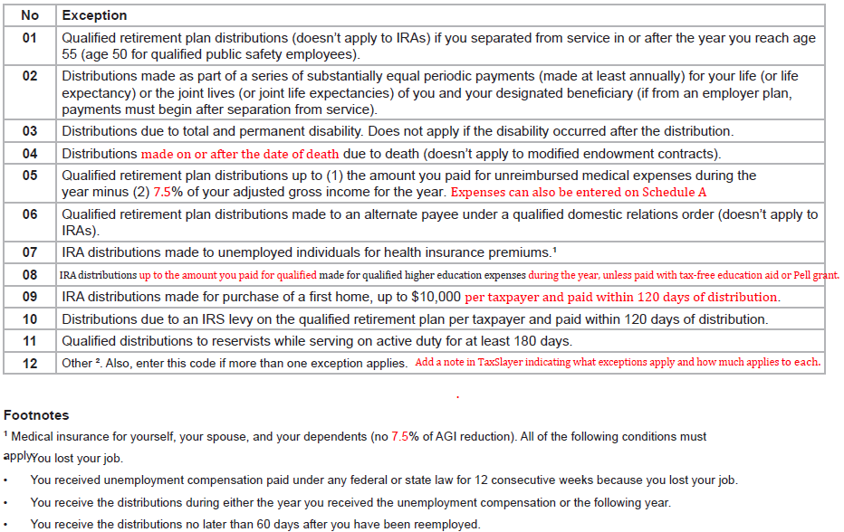
Exceptions to Early Distribution Penalty (Pub 4012 Page H-5)
Exception code 08 is applicable
for Caldwell
Be sure to read
footnotes and
examples on
Page H-4.1 and
H-4.2
Note that some codes apply only to certain types of distributions:
Only IRAs
Not IRAs
Qualified retirement plans
For codes 05, 07 and 08, the distributions do not have to be specifically for the stated expenses,
but the distribution and the expenses must occur in same tax year (Page H-4.1)

Slide 85
Qualified Education Expenses for Early Distribution Penalty Exception
Caldwell education expenses:
  College tuition $10,200
  Books + 275
  Minus scholarships - 6,700
    Total education expenses $3,775
  Distribution from IRA $3,500

Slide 86
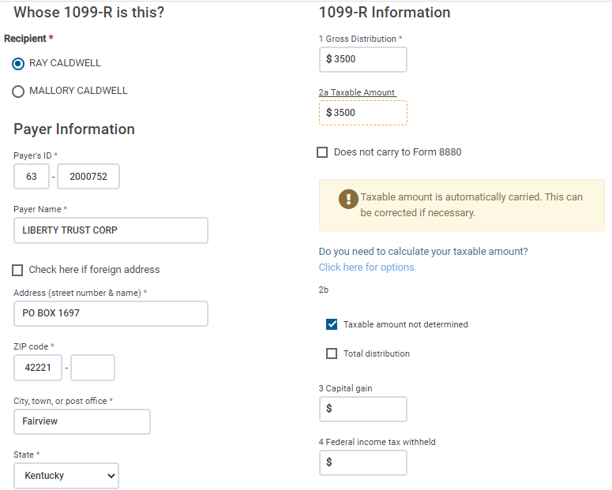
TSO – Entering IRA Distribution on 1099-R Screen
Federal Section>Income>1099-R>Add or Edit a 1099-R
Gross amount of distribution
Taxable amount of distribution;
TSO populates based on Box 1;
Correct if needed

Slide 87
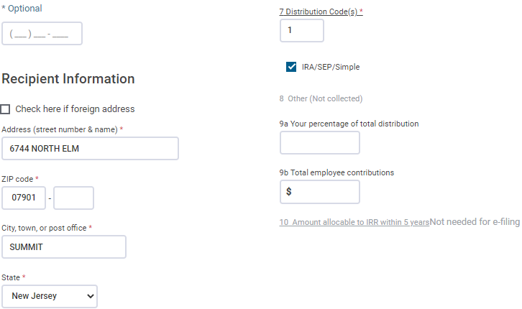
TSO – Entering IRA Distribution on 1099-R Screen
Federal Section>Income>1099-R>Add or Edit a 1099-R
cont’d
Code 1 for early distribution,
no known exception
Check for IRA
distribution

Slide 88
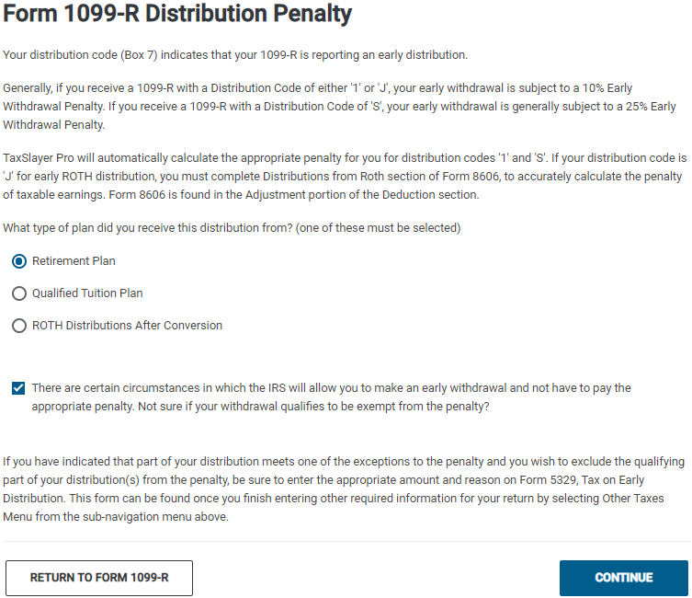
TSO – Explanation of Form 1099-R Distribution Penalty
What type of plan did you receive
this distribution from?

Slide 89
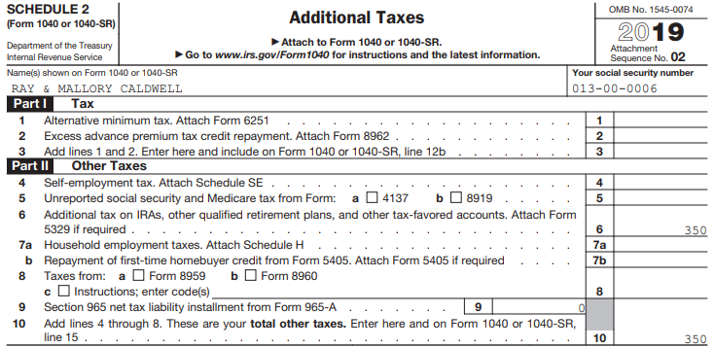
Early Distribution Penalty on Schedule 2
TSO calculates penalty before exception

Slide 90
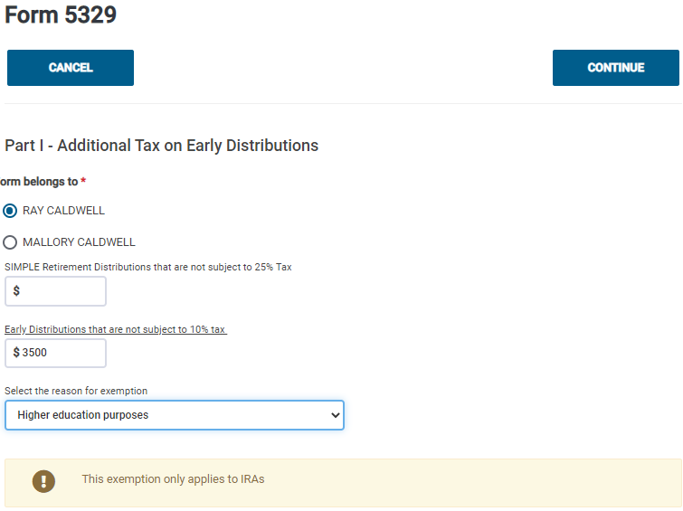
TSO - Exception to Early Distribution Penalty on Form 5329
Federal Section>Other Taxes>Tax on Early Distribution
Early distribution not subject to 10% tax
Reason for exception

Slide 91
TSO - Student Activity
Federal Section>Income>1099-R>Add or Edit a 1099-R
Federal Section>Other Taxes>Tax on Early Distribution
Pause the slide show
Enter the Liberty Trust Corp IRA Distribution 1099-R into TSO (Step 5)
Request an exemption for the 10% early distribution penalty on the Form 5329 screen (Step 5a)
Check the Federal and NJ refund monitors as you do each step

Slide 92
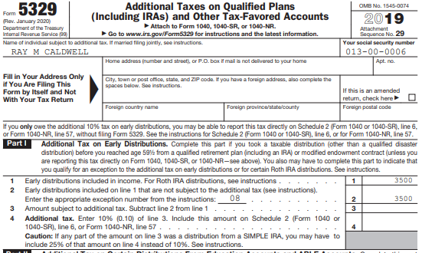
TSO – Exception for Early Distribution Penalty on Form 5329
Reason code for exception
Amount not subject to 10% penalty

Slide 93
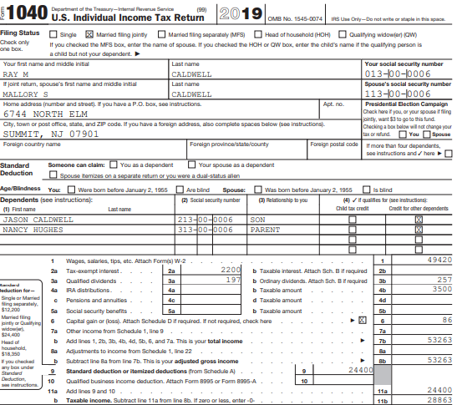
TSO - IRA Distribution on Federal 1040
IRA distribution

Slide 94

TSO – IRA Distribution on NJ 1040
IRA distribution

Slide 95
Scenario Step 6
Jury Duty Pay

Slide 96
Jury Duty Pay and Repayment of Jury Duty Pay to Employer
Jury duty pay reported as Other Income
  No tax form may be issued if amount is < $600, but income must still be reported
If employee salary is paid during jury duty, employer may require that some or all of jury duty pay be repaid to employer
  Amount repaid to employer may be claimed as an Adjustment to Income
    Covered later in Adjustment section

Slide 97
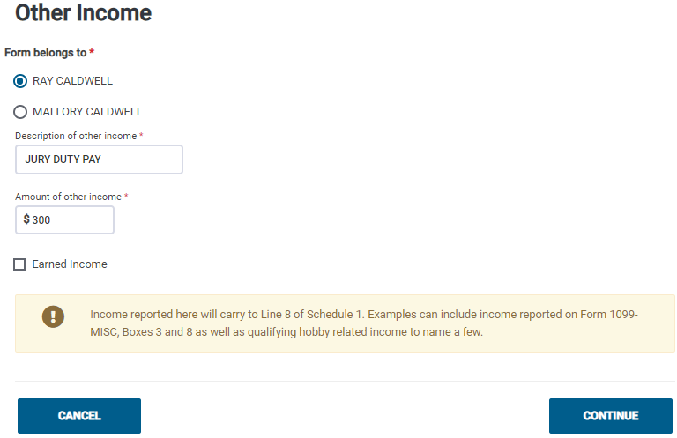
TSO - Jury Duty Pay as Other Income
Federal Section>Less Common Income>Other Income Not Reported Elsewhere
Jury duty pay

Slide 98
TSO - Student Activity
Federal Section>Less Common Income>Other Income Not Reported Elsewhere
Pause the slide show
Enter the jury duty pay Caldwell received into TSO (Step 6)
Check the Federal and NJ refund monitors

Slide 99
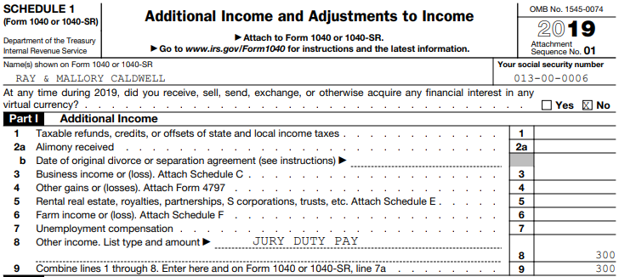
TSO - Jury Duty Pay on Schedule 1, Part I
Type of Other Income
Jury duty pay
Total of all Additional
Income

Slide 100
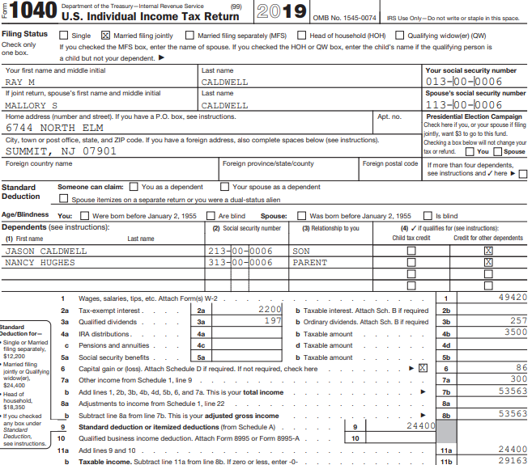
TSO - Jury Duty Pay on Federal 1040
Transferred from Schedule 1, Part I, total

Slide 101
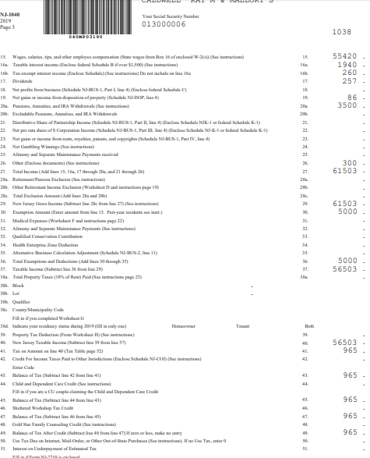
TSO - Jury Duty Pay on NJ 1040
Jury duty pay

Slide 102
Scenario Step 7
Self-Employment Income

Slide 103
Self-Employment Income
In business for self as a sole proprietor or independent contractor
Trade or business carried on with expectation of making a profit
  Must report sales, expenses, and net profit on Schedule C
  Net loss is out of scope
Difference between employee and independent contractor
  Employee – Employer controls when, where, and how employee works
  Independent contractor – performs services for others (considered self-employed)

Slide 104
What is Considered a Business?
Facts and circumstances:
  Profit motive
  Reasonable expectation of profit
  Means of livelihood
  Regular activity
  Conducted in a business-like manner

Slide 105
What is Income Producing, But Not Considered a Business?
Facts and circumstances:
  Sporadic activity
    E.g. - one-time fee
  Gambling winnings
  Investing
  Sale of personal assets
    E.g. - yard sales, Craig’s list, etc.

Slide 106
Hobbies/Activities Not Entered Into for Profit
Facts and circumstances:
  Model airplane contest
  Beer mug collecting
  Antique hunting, when not a business
Usually, more pleasure driven than income driven
Not-for-profit activities are out of scope

Slide 107
Requirements for Business Income To Be In Scope
Business expenses of $25,000 or less
Cash method of accounting (not accrual)
No inventory
Only sole proprietor business
No employees or contract labor
No depreciation/amortization

Slide 108
Requirements for Business Income To Be In Scope
cont’d
No deduction for business use of home (Home Office)
  Includes the “simplified option for home office deduction”
No transactions involving virtual currency (bitcoins)
Must use standard mileage rate for auto expenses
No car or equipment rental/lease for more than 30 days
No prior year disallowed passive activity loss
Business cannot operate at a loss

Slide 109
Scenario Step 7a
1099-MISC

Slide 110
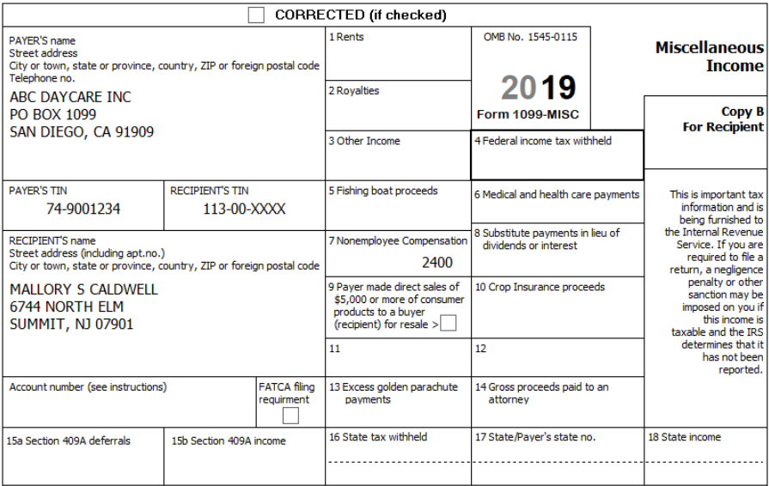
Form 1099-MISC
Nonemployee compensation

Slide 111
Entering Income Reported on 1099-MISC
Must enter income in proper 1099-MISC box so that it flows to proper Schedule
  Must probe with taxpayer to understand what income is for
  May enter income in different box than shown on 1099-MISC (different than rules for other forms)
    Example: Client gets a 1099-MISC with income in box 7 for a one time service. Since this is not a regular business, the amount can be entered in box 3 rather than box 7.

Slide 112
Types of Income Reported on 1099-MISC
Type of Income | Examples | Box To Enter In | Schedule It Flows To
Royalties for use of property | Oil and gas | 2 | Sch E
Royalties as a result of self-employment | Writers, singers, etc. | 7 | Sch C
Other income not reported elsewhere | Prizes, awards | 3 | Sch 1, Line 8
Other income that is misreported self-employment | Recurring activity | 7 | Sch C
Nonemployee compensation for an independent contractor | Uber/Lyft driver, sole proprietor business | 7 | Sch C
Nonemployee compensation that is not really a business | Non-recurring or sporadic activity | 3 | Sch 1, Line 8
For Caldwell

Slide 113
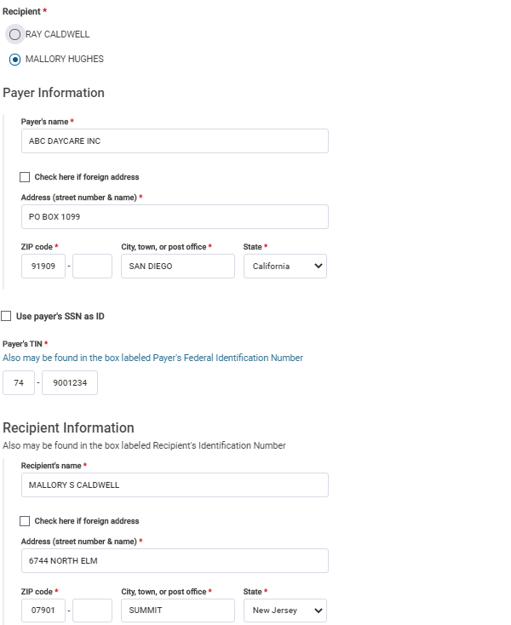
TSO – Entering Self-Employment Income Reported on a 1099-MISC
Federal Section>Income>1099-MISC
Whose 1099-MISC is this?
Choose Mallory
Payer’s name and address; enter zip code;
TSO populate city and state; must change
Chula Vista to San Diego to match printed
1099-MISC
Payer’s ID
Be sure that Mallory’s name matches printed
1099-MISC

Slide 114
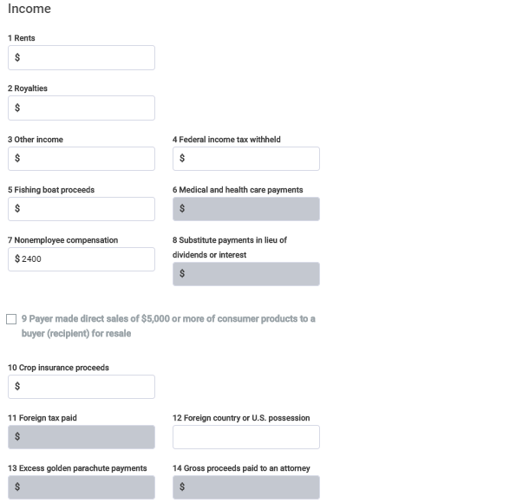
TSO – Entering Self-Employment Income Reported on a 1099-MISC
Federal Section>Income>1099-MISC
cont’d
Probe to determine that this is really nonemployee compensation; since it is, enter
income in Box 7

Slide 115

TSO – Creates a Schedule C

Slide 116
TSO - Student Activity
Federal Section>Income>Form 1099-MISC
Pause the slide show
Enter Mallory’s Form 1099-MISC into TSO (Step 7a)
  Link the 1099-MISC to Schedule C
Check the Federal and NJ refund monitors

Slide 117
Scenario Step 7b
Business Income

Slide 118

TSO - Schedule C Menu
Federal Section>Income>Profit or Loss from a Business
Complete as appropriate
for Mallory’s business
Out of scope

Slide 119

TSO – Entering Basic Information About Your Business
Federal Section>Income>Profit or Loss from a Business>Basic Information About Your Business
Business belongs to Mallory
Since Mallory’s business does not
have a separate name or address,
leave this section blank
Find business code using NAICS
Search link on TP4F Preparer page
TSO populates based on business code

Slide 120

Schedule C Business Codes - NAICS Search Tool
TP4F Preparer Page – left column
Search word
Best fit for Mallory’s
business

Slide 121

TSO – Entering Answers to Questions About the Operation of Your Business
Federal Section>Income>Profit or Loss from a Business>Questions About Operation of Business
TSO automatically populates
most answers; if answers for
Mallory’s business differ from
default answers, out of scope
Check here if this is the first
Schedule C filed by you for
this business

Slide 122

TSO – Entering Income
Federal Section>Income>Profit or Loss from a Business>Income
TSO automatically populates
from 1099-MISC
Cash payments

Slide 123
TSO - Student Activity
Federal Section>Income>Profit or Loss from a Business
Pause the slide show
Enter information about Mallory’s business on these 3 screens in TSO (Step 7b):
  Basic Information About Your Business
  Questions About the Operation of Your Business
  Income
Check the Federal and NJ refund monitors

Slide 124
CALDWELL INTEGRATED SCENARIO – STEP 7C
BUSINESS GENERAL EXPENSES

Slide 125
Allowable Business Expenses
Ordinary and necessary to the business
Not against public policy
  Cannot deduct fines or penalties
All allowable and documented expenses must be claimed
  Not claiming an expense may result in a tax benefit that would not otherwise occur (e.g., it may improve EIC). That is not allowed

Slide 126
Allowable Business Expenses cont’d
Repairs and maintenance
Supplies
Taxes
Travel
Utilities
50% of business meals/entertainment
Professional fees
Advertising
Auto expenses
Commissions/fees
Insurance
Interest
Office & rent expense
Legal/professional services

Slide 127

TSO - Entering Expenses
Federal Section>Income>Profit or Loss from a Business>General or Other Expenses

Slide 128

TSO - Entering Expenses
Federal Section>Income>Profit or Loss from a Business>General Expenses

Slide 129

TSO – Entering Expenses
Federal Section>Income>Profit or Loss from a Business>Other Expenses
Include all allowable and documented expenses;
Enter each expense separately by clicking on Add a Schedule C
Other Expenses

Slide 130
TSO - Student Activity
Federal Section>Income>Profit or Loss from a Business>Other Expenses
Pause the slide show
Enter Mallory’s business expenses (other than car expenses) into TSO (Step 7c):
Check the Federal and NJ refund monitors

Slide 131
CALDWELL INTEGRATED SCENARIO – STEP 7D
BUSINESS CAR AND TRUCK EXPENSES

Slide 132
Car and Truck Business Expenses
Standard mileage deduction must be used – 58 cents/mile
  Only parking and tolls can be added
  All of the following are included in standard mileage
    Depreciation or lease payments
    Maintenance and repairs
    Gasoline (including gasoline taxes) or oil
    Insurance
    Vehicle registration fees
    Car washes
  Cannot claim actual car and truck expenses – out of scope

Slide 133
Car and Truck Mileage Breakdown
Commuting miles
  Miles driven from your home to your place of work and back home (first and last trips of the day)
  Are not deductible as business expenses
Business miles
  Any other miles driven for business
    Includes miles driven between jobs
  Are deductible as business expenses
Other miles
  Personal use
  Not deductible as business expenses
Must have written records to substantiate your mileage

Slide 134

TSO – Entering Car and Truck Expenses
Federal Section>Income>Profit or Loss from a Business>Car and Truck Expenses
Description of vehicle
Date placed into
business use
Separate business, commuting and personal miles
Check boxes as appropriate

Slide 135
TSO - Student Activity
Federal Section>Income>Profit or Loss from a Business>Car and Truck Expenses
Pause the slide show
Enter Mallory’s car expenses into TSO (Step 7d)
Check the Federal and NJ refund monitors

Slide 136
Self-Employment Taxes
Must pay Social Security and Medicare taxes on Schedule C net income
  Net income from self-employment must be over $400 to owe self-employment taxes
Self-employment tax rate is 15.3% (Social Security -12.4%; Medicare - 2.9%)
  Same as amount on employees’ wages, which is paid ½ by employer and ½ by employee
Can deduct the employer-equivalent portion of self-employment tax as an adjustment to income
Notes:
136

Slide 137
Self-Employment Taxes
cont’d
Entries on Schedule C will cause TSO to:
  Calculate Self-Employment Tax on Schedule SE
    Result transferred to Schedule 2, Part II, Line 4
  Record Adjustment to Income for ½ of Self-Employment Tax
    Reported on Schedule 1, Part II, Line 14
  Carry business net profit to EIC and Traditional IRA calculations
  Calculate Qualified Business Income (QBI) deduction
Notes:
137

Slide 138
Qualified Business Income (QBI)
Refer to Pub 4012 Page F-12
What is included in QBI?
  Sole proprietor Schedule C income (combined if more than one Schedule C)
  Other pass-through entity business income
    Such as partnerships, S corporations, limited liability companies
    All pass-through entities with business income are out of scope
  Real Estate Investment Trust (REIT) Section 199A dividends
    Reported on 1099-DIV in Box 5

Slide 139

Section 199A Dividends on Form 1099-DIV

Slide 140
Qualified Business Income (QBI)
cont’d
Out of scope for:
  Taxable income over $160,700 ($321,400 if MFJ)
  Publicly traded partnership income
Individual taxpayers can deduct up to 20% of qualified business income (QBI)
  A deduction from AGI to arrive at taxable income
  In addition to standard or itemized deductions
  TSO automatically calculates and populates on 1040 Line 10
Calculations on Schedule C and SE are not affected by QBI deduction
Taxable income is not reduced below 0 by the 20% deduction

Slide 141

TSO – Schedule C
Gross income:
$2,400 from 1099-MISC
$5,500 cash
Car expenses
Total expenses
Net profit

Slide 142

TSO - Calculation of Self-Employment Tax and Adjustment for ½ of Self-Employment Tax on Schedule SE
Self-employment tax
Adjustment for ½ of
self-employment tax

Slide 143

TSO – Schedule 1
Business income
bonant@aol.com
Total of all Additional Income
Deductible part of self-
employment tax

Slide 144

TSO – Schedule 2, Part II
Self-employment
tax
Total of all
Other Taxes

Slide 145

TSO - Business Income and QBI on Federal 1040
Additional Income transferred from Schedule 1, Part I:
Jury Duty Pay + Business
Income
Adjustments to Income
transferred from Schedule
1, Part II
QBI deduction

Slide 146

TSO - Business Income on NJ 1040
NJ net profit from business

Slide 147
Self-Employed Health Insurance Deduction
If taxpayer has self-employment income, they may be eligible to claim health insurance premiums as an adjustment to income, instead of on Schedule A
  Advantages: Does not have to itemize, not subject to 7.5% threshold, reduces AGI
Refer to Pub 4012 Pages E-4 and E-4.1
Claimed on Schedule 1, Part II, Line 16
Enter on Sch C General Expenses screen in TSO
  TSO automatically transfers as an adjustment to income
  Will not be included on Schedule C

Slide 148
Self-Employed Health Insurance Deduction
cont’d
Includes health insurance coverage for
  Taxpayer
  Spouse
  Dependents
  Child under 27 (as of year end) even though not the taxpayer’s dependent
    “Child” includes stepchild, adopted child or foster child, but not grandchildren
Health coverage must be “established under the trade or business”
  Policy can be in name of the individual or the business for taxpayers filing Schedule C
    Individual can be taxpayer, spouse, dependent, or child

Slide 149
Self-Employed Health Insurance Deduction
cont’d
Qualifying insurance includes
  Medicare
    Can be paid by taxpayer or spouse when filing MFJ
  Other health coverage if not eligible for subsidized health coverage
    Includes dental, vision, supplemental, limited coverage, etc.
  Long-term care (LTC) insurance

Slide 150
Self-Employed Health Insurance Deduction
cont’d
The taxpayer cannot be eligible for subsidized coverage
  From any employer: own, spouse’s, dependent’s, or child’s
  Prior employers do not count
    Premiums paid for retiree coverage qualify
  Test LTC plan separately from other employer health plan offers to determine whether subsidized
    E.g., if LTC is not subsidized, can claim its cost even though taxpayer eligible for subsidized medical coverage

Slide 151

TSO – Entering Self-Employed Health Insurance
Federal Section>Income>Profit or Loss From a Business>General Expenses
Even though entered on
Schedule C expense screen,
TSO knows to transfer to
Adjustment to Income section
on Schedule 1

Slide 152

TSO – Self-Employed Health Insurance on Schedule 1, Part II

Slide 153
Adjustments to Income
Ray Caldwell

Slide 154
Scenario Step 8
Educator Expenses

Slide 155
Educator Expenses
Refer to Pub 4012 Page E-3
Can claim an adjustment to income for out-of-pocket expenses paid for classroom materials or professional development
  Maximum adjustment $250
    If taxpayer and spouse are both eligible educators, can deduct up to $500, but neither can deduct more than their own expenses up to $250
  Classroom expenses include books, supplies, equipment (including computer equipment, software, and services) and other materials used in classroom
Eligibility requirements
  Teacher, instructor, counselor, principal or aide in grades K – 12
  Must work 900 hours in school year

Slide 156
Educator Expenses on Pub 4012 Page E-3

Slide 157

TSO – Entering Educator Expenses
Federal Section>Deductions>Adjustments>Educator Expenses
Educator expenses

Slide 158
TSO - Student Activity
Federal Section>Deductions>Adjustments>Educator Expenses
Pause the slide show
Enter Ray’s educator expenses adjustment into TSO (Step 8)
Check the Federal and NJ refund monitors

Slide 159

TSO – Educator Expenses on Schedule 1, Part II
Educator expenses
Total of all
Adjustments to Income

Slide 160

TSO – Educator Expenses on Federal 1040
Transferred from Schedule 1,
Part II, total

Slide 161
Scenario Step 9
Jury Duty Repayment To Employer

Slide 162
Jury Duty Repayment to Employer
Some employers continue to pay employee while they’re serving on jury duty
Employee may then be required to repay to employer all or part of jury duty pay received
Must show jury duty pay received as Other Income
  Do not include expense reimbursements
Claim an adjustment to income for amount repaid to employer
Notes:
162
162

Slide 163
Jury Duty Repayment to Employer on NJ Return
For NJ, employee can report just net amount of jury duty pay they could keep
  Total jury duty pay minus amount repaid to employer
Federal Other Income flows through to NJ Other Income, so must subtract amount repaid to employer from NJ Other Income line
  Note amount repaid on NJ Checklist as a negative adjustment to Line 26 – Other Income in Income Subject to Tax section

Slide 164

Jury Duty Repaid to Employer on NJ Checklist

Slide 165

TSO – Entering Jury Duty Repayment to Employer
Federal Section>Deductions>Adjustments>Other Adjustments
Choose Jury Duty Pay from drop-down menu
Enter amount repaid to employer

Slide 166
TSO - Student Activity
Federal Section>Deductions>Adjustments>Other Adjustments
Pause the slide show
Enter Ray’s jury duty repayment adjustment into TSO (Step 9)
Check the Federal and NJ refund monitors

Slide 167

TSO – Jury Duty Repayment on Schedule 1, Part II
Jury duty repayment
Total of all
Adjustments to Income

Slide 168

TSO – Jury Duty Repayment on Federal 1040
Transferred from Schedule 1,
Part II, total

Slide 169
Deductions
Ray Caldwell

Slide 170

Standard Deduction – Pub 4012 Page F-1
Standard Deduction for MFJ
170

Slide 171
Itemized Deductions for Caldwell
Since it is obvious that the standard deduction for the Caldwells will be higher than itemized deductions, it is not necessary to enter all itemized deductions
  Still enter medical expenses on Schedule A so they will flow through to NJ
    If medical expenses exceed 2% of NJ gross income, they will reduce NJ tax owed

Slide 172

TSO – Entering Medical Expenses on Schedule A
Federal Section>Deductions>Itemized Deductions>Medical and Dental Expenses
Medical expenses

Slide 173
TSO - Student Activity
Federal Section>Deductions>Itemized Deductions>Medical and Dental Expenses
Pause the slide show
Enter Caldwell’s medical expenses as itemized deductions into TSO (Step 10)
Check the Federal and NJ refund monitors

Slide 174

TSO – Medical Expenses on NJ 1040
NJ medical expenses

Slide 175
Credits
Ray Caldwell

Slide 176
Scenario Step 11
Credit For Other Dependents

Slide 177
Credit for Other Dependents
Refer to Pub 4012 Page G-4
$500 non-refundable credit
For dependents who do not qualify for Child Tax Credit
  E.g. - dependent parent or sibling, dependent child who is age 17 or older, dependent child who does not have SS #
  Cannot be claimed for taxpayer or spouse
Dependent must be U.S. citizen, national, or resident of U.S.
Dependent must have a valid identification # (ATIN, ITIN, or SS #)

Slide 178
TSO – Credit for Other Dependents
On the Caldwell return, Jason Caldwell and Nancy Hughes qualify for the Credit for Other Dependents
  Jason is a dependent child who is age 17 or older
  Nancy is a dependent parent
TSO automatically creates this credit in the background as soon as Dependent info is entered
  No need for any further entry in this step
  Refund monitors do not change in this step since already done earlier

Slide 179

TSO – Credit for Other Dependents on Federal 1040 Page 1
Both Jason Caldwell and
Nancy Hughes qualify for
the Credit for Other Dependents

Slide 180

TSO – Credit for Other Dependents on Federal 1040 Page 2
Credit for Other Dependents
for Jason Caldwell and
Nancy Hughes

Slide 181
Scenario Step 12
Education Expenses

Slide 182

Tuition Statement - Form 1098-T
Tuition and fees expenses
Scholarships or grants
At least half-time student

Slide 183
Ways to Claim Education Expenses
Multiple ways to claim education expenses
  American Opportunity Credit (AOC)
    Can reduce tax bill by up to $2,500
      100% of first $2,000 of qualified expenses
      25% of next $2,000 of qualified expenses
  Lifetime Learning Credit (LLC)
    Can claim up to 20% of first $10,000 of qualified expenses
  Tuition & Fees Deduction
    Can deduct up to $4,000 from gross income for qualified expenses
  Business Expense
    Can reduce Schedule C profit and self-employment taxes
Notes:
183

Slide 184
Ways to Claim Education Expenses
cont’d
Phase out limits differ for each credit/deduction
  TSO applies limits automatically
If taxpayer meets eligibility to claim expenses in multiple ways, must choose only one way for the same expenses
For each person, can only use one way; however, different people can use different ways
  Example:
  Taxpayer has dependent who is in 1st year of college – AOC
  Taxpayer takes course at local community college – LLC
Notes:
184

Slide 185
Ways to Claim Education Expenses
cont’d
Enter data for each credit/deduction to determine which is best for taxpayer
Always run scenarios after all other return data entered, so all other figures finalized
Notes:
185

Slide 186

Education Credits Overview – Pub 4012, Tab J

Slide 187

Education Credits Overview – Pub 4012, Tab J

Slide 188
General Requirements for Claiming Education Expenses
Paid qualified expenses for eligible student
  May be taxpayer, spouse or dependent claimed on return
Attended an eligible post-secondary institution
Taxpayer’s income must not exceed limits (phase-out based on modified AGI)
Taxpayer cannot claim if filing MFS
Taxpayer cannot be a non-resident alien
Taxpayer cannot be listed as a dependent on someone else’s return
Notes:
188

Slide 189
Qualified Expenses
Expenses paid in current tax year for academic period beginning current tax year or first 3 months of following year
Expenses not refunded upon withdrawal
Expenses may be paid with proceeds from a loan
Include tuition & academic fees
Course-required books, supplies, equipment
  LLC and Tuition & Fees Deduction only allow if paid to institution as condition of enrollment
    LLC books can be purchased at institution only
  AOC allows, regardless if paid to institution as condition of enrollment
Notes:
189

Slide 190
Adjustment To Qualified Expenses
Qualified tuition expenses must be reduced by amount paid with:
  Tax-free scholarships & fellowships
  Pell grants
  Employer-provided educational assistance
  Veteran’s educational assistance
  Any other nontaxable payments (other than gifts, bequests, or inheritances) received for education expenses
Notes:
190

Slide 191
Non-Qualified Expenses
Room & board
Transportation
Medical expenses
  Including student health fees
Insurance
Courses involving sports, hobbies, games
Non-credit courses (unless part of degree program)
  LLC allows if course helps to acquire/improve job skills
Notes:
191

Slide 192
Who Can Claim Credit/Deduction?
If taxpayer claims dependency exemption – taxpayer claims education credit
If taxpayer does not claim dependency exemption (even if entitled) – student claims credit
If someone other than taxpayer, spouse, or dependent makes payment (even directly to institution), student is considered as making payment (considered gift to student)
  Taxpayer or student claims credit as above
Note: CLAIMING CREDIT DOES NOT DEPEND ON WHO PAYS EXPENSES
Notes:
192

Slide 193
American Opportunity Credit (AOC)
This credit has two parts:
  Nonrefundable credit
    Maximum credit per student: Up to $2,500 in tax credits on the first $4,000 of qualifying educational expenses
  Refundable credit
    Maximum credit per student: Up to $1,000 in tax credit (40% of qualified educational expenses)
Can receive full credit for multiple students, for up to 4 years per student

Slide 194
AOC Specific Requirements
Enrolled in one of first four years of post-secondary education
  Graduate student can claim if and only if they haven’t completed first four years before beginning of tax year
Enrolled in program that leads to degree or other recognized credential
Taking at least ½ of normal full-time workload
Never convicted of felony for drugs
Notes:
194

Slide 195

Special Rules for Student Under Age 24 Claiming AOC - Pub 4012 Page J-9
Decision tree helps determine
if student under 24 can claim
refundable part of AOC

Slide 196
Lifetime Learning Credit (LLC) Specific Requirements
Nonrefundable credit
Based on total qualified expenses paid by taxpayer – not on number of eligible students
NOT necessary to be enrolled in degree program
  Includes courses taken for degree or to improve/acquire job skills
No limit on # of years that taxpayer can claim credit
Maximum credit: Up to $2,000 per return (20% of first $10,000 of qualified expenses)
  E.g. - Two dependents, each with $1,600 qualified expenses. Max credit still only $2,000 for return
Notes:
196

Slide 197

Comparing AOC and LLC – Pub 4012 Page J-4

Slide 198

Tuition and Fees Deduction Requirements – Pub 4012 Page Ext-6
Deduction that reduces AGI (up to $4,000)
  Not a credit that directly reduces tax liability dollar for dollar
Only include books and supplies
if purchased through school as
a condition of enrollment

Slide 199

TSO – Entering Education Expenses for Tuition and Fees Deduction
Federal Section>Deductions>Credits Menu>Education Credits Form 1098-T
Choose which method to try –
Tuition and fees deduction
Qualified education expenses for Tuition and Fees deduction:
Tuition and fees: $10,200
- Scholarship: 6,700
TOTAL: $3,500
Book expenses not qualified

Slide 200

TSO – Tuition and Fees Education Expenses on Schedule 1, Part II

Slide 201

TSO – Entering Education Expenses for LLC
Federal Section>Deductions>Credits Menu>Education Credits Form 1098-T
Choose which method to try - LLC
Qualified education expenses for LLC:
Tuition and fees: $10,200
- Scholarship: 6,700
TOTAL: $3,500
Book expenses not qualified; not
purchased through institution as a
condition of enrollment
Additional questions same as AOC

Slide 202

TSO – Entering Education Expenses for LLC
Federal Section>Deductions>Credits Menu>Education Credits Form 1098-T
cont’d

Slide 203

TSO – LLC Education Credits on Form 8863
No refundable credit for LLC
Nonrefundable LLC = $700

Slide 204

TSO – Entering Education Expenses for AOC
Federal Section>Deductions>Credits Menu>Education Credits Form 1098-T
Choose which method to try - AOC
Qualified education expenses for AOC:
Tuition and fees: $10,200
+ Books purchased online 275
- Scholarship: 6,700
TOTAL: $3,775

Slide 205

TSO – AOC Education Credits on Form 8863
Refundable AOC = $978
Nonrefundable AOC = $1,466

Slide 206
TSO – Entering Education Expenses as a Business Expense
Can only be used if taxpayer has self-employment income (not an employee)
Make sure the coursework qualifies as a business expense
  Required by law to keep present job, salary, status
  Maintains or improves job skills
May be able to claim transportation and travel expenses
Enter as an expense on Schedule C
Reduces AGI and self-employment taxes

Slide 207
Summary - Choosing Best Method to Claim Education Expenses
Enter education expenses in multiple ways to determine which is best for taxpayer
Check combination of Federal and NJ refund monitors
  Education expenses cannot be claimed on NJ return
  However, entering education expenses on Federal return can indirectly affect NJ return
    E.g. – Claiming Tuition and Feeds deduction as an adjustment to income can change Federal EIC; NJ EITC would also change, since it is a percentage of Federal EIC
AOC results in highest refund totals for Caldwell
  Make sure AOC is final choice and data entry for other methods is removed if appropriate

Slide 208
TSO - Student Activity
Federal Section>Deductions>Credits Menu>Education Credits Form 1098-T
Pause the slide show
Enter the qualified education expenses from Oakland University 1098-T and supplemental info into TSO (Step 8)
Check the Federal and NJ refund monitors

Slide 209

TSO – Nonrefundable AOC on Schedule 3, Part I
Nonrefundable AOC
Total of all
nonrefundable
credits

Slide 210

TSO - AOC on Federal 1040
Nonrefundable AOC included in Line 13b
Total of Line 13b:
Schedule 3, Part I, $1,485
Credit for other
dependents-Line 13a
$1,000
$2,485
Refundable AOC

Slide 211
Payments and Estimates
Ray Caldwell

Slide 212
Scenario Step 13
Estimated Tax Paid

Slide 213
Estimated Tax Payments
Means of tax payment for:
  Self-employed
  Those with investment income
  Those whose Social Security becomes partially taxable
Should make estimated tax payments if projected tax liability exceeds certain limits
  Projected Federal balance due > $1,000
  Projected NJ balance due > $400
Notes:
213

Slide 214
Estimated Tax Payments cont’d
Payments made periodically by taxpayer
  Due on 4/15, 6/15, 9/15 and 1/15 of subsequent year (may change due to weekends or holidays)
  Need to know “When” & “How Much” for each estimated tax payment made for current tax year
Estimated tax payments are mailed in separately from tax return
  Particularly important for payment due 4/15
  Voucher should be sent in with payment
Notes:
214

Slide 215
How Do Estimated Taxes Impact Returns?
Federal:
  TSO adds estimated tax payments to other Federal withholdings from W-2s, 1099s, etc. to calculate total taxes paid during tax year
    As long as paid during tax year, not just billed
NJ
  TSO adds estimated tax payments to other NJ withholdings from W-2s, 1099s, etc. to calculate total NJ taxes paid during tax year
    As long as for current year’s taxes, doesn’t matter when paid
  TSO adds NJ estimated tax payments to State and Local Tax Paid deduction on Schedule A Line 5a
    As long as paid during tax year can be for any year’s taxes

Slide 216

TSO – Federal Estimated Tax Payments
Federal Section>Payments and Estimates>Federal Estimated Tax Payments
Federal estimated tax
payment for 6/15

Slide 217

TSO – State Estimated Tax Payments
Federal Section>Payments and Estimates>State Estimated Payments
NJ estimated tax
payment for 6/15
Be sure to put last payment on correct line to show
if paid before or after 12/31 of tax year;
Needed to correctly calculate Schedule A amount for
taxes paid during tax year

Slide 218
TSO - Student Activity
Federal Section>Payments and Estimates>Federal Estimated Tax Payments
Federal Section>Payments and Estimates>State Estimated Payments
Pause the slide show
Enter the Federal and NJ estimated tax payments into TSO (Step 13)
Check the Federal and NJ refund monitors

Slide 219

TSO – Federal Estimated Tax Payments on Schedule 3, Part II
Estimated tax payment

Slide 220

TSO – NJ Estimated Tax Payments on Schedule A
NJ withholding from W-2s
+ NJ estimated tax payment

Slide 221

TSO – NJ Estimated Tax Payments on NJ 1040
NJ estimated tax payment

Slide 222
Federal Health Insurance
Ray Caldwell

Slide 223
Scenario Step 14
Health Insurance (Federal)

Slide 224

TSO – Entering Federal Health Insurance Info
Health Insurance section

Slide 225
TSO - Student Activity
Health Insurance section
Pause the slide show
Complete Federal TSO Health Insurance section by stating that Caldwell did not purchase insurance through the Marketplace (Step 14)
Check to ensure that Federal and NJ refund monitors did not change from prior step

Slide 226
State Section
Ray Caldwell

Slide 227
Scenario Step 15
NJ Return

Slide 228
Scenario Step 15a
NJ Property Tax Credit Or Deduction

Slide 229
NJ Property Tax Credit or Deduction
Refer to NJ Special Handling document
See Andrews problem for basic Property Tax Credit/Deduction information
Caldwells can claim 18% of their rent as property taxes

Slide 230

Scratch Pad for Caldwell Rent
Total property tax
that can be claimed
Use formula to calculate
18% of yearly rent

Slide 231

NJ Checklist – Property Tax Information
18% of rent

Slide 232

TSO – Entering Property Tax Credit/Deduction
State Section>NJ>Credits>Property Tax Credit/Deduction
Refer to NJ Special Handling document for requirements
18% of rent paid
Renter

Slide 233
TSO - Student Activity
State Section>NJ>Credits>Property Tax Credit/Deduction
Pause the slide show
Enter the Property Tax information from the NJ Checklist Credits section into TSO State Section (Step 15A)

Slide 234

TSO – Property Tax Deduction on NJ 1040
NJ property tax deduction

Slide 235
Scenario Step 15b
NJ Health Insurance

Slide 236

TSO – Entering NJ Health Care Coverage
State Section>Tax>Health Care Coverage (Sch NJ-HCC)
NJ Health Mandate will be covered in
more detail in a separate module
NJ health insurance status

Slide 237
TSO - Student Activity
State Section>Tax>Health Care Coverage (Sch NJ-HCC)
Pause the slide show
Enter the NJ Health Insurance Information into TSO State Section (Step 15B)

Slide 238
Scenario Step 15c
NJ Basic Information

Slide 239

NJ Checklist – Basic Information Section

Slide 240

TSO – Entering NJ Basic Information Section
State Section>NJ>Basic Information
# of claimed dependents under 22 who attended college

Slide 241

TSO – Entering NJ Basic Information Section
State Section>NJ>Basic Information
cont’d

Slide 242
TSO - Student Activity
State Section>NJ>Basic Information
Pause the slide show
Enter the items from the NJ Checklist Basic Information section into TSO State Section (Step 15c)
  Must click Save/Back a few times and then Exit New Jersey Return before TSO will update NJ refund monitor
Check the Federal and NJ refund monitors

Slide 243

TSO – NJ 1040
Extra exemption amount
for college student under 22

Slide 244
Scenario Step 15d
NJ Income Subject To Tax

Slide 245

NJ Checklist – Income Subject to Taxes Section
Caldwell does not
know amount of IRA
contributions so entire
distribution is taxable
For NJ;
Amount flows through
from Federal

Slide 246

TSO – Entering NJ Income Subject to Tax Info
State Section>NJ>Income Subject to Tax
NJ net gambling winnings
TSO tells you Federal winnings
To remove disability income (under age 65) from NJ
To reduce jury duty pay for amount
repaid to employer

Slide 247

TSO – Jury Duty Pay on NJ 1040
NJ net jury duty pay

Slide 248
TSO - Student Activity
State Section>NJ>Income Subject to Tax
Pause the slide show
Enter the items from the NJ Checklist Income Subject to Tax section into TSO State Section (Step 15D)
  Must click Save/Back a few times and then Exit New Jersey Return before TSO will update NJ refund monitor
Check the Federal and NJ refund monitors

Slide 249
Scenario Step 15e
NJ Subtractions From Income

Slide 250

NJ Checklist – Subtraction from Income Section

Slide 251

TSO – Entering NJ Subtractions From Income Info
State Section>NJ>Subtractions From Income
To add health insurance premiums payroll deductions
to NJ medical expenses

Slide 252
TSO - Student Activity
State Section>NJ>Subtractions From Income
Pause the slide show
Enter the items from the NJ Checklist Subtractions from Income section into TSO State Section (Step 15E)
  Must click Save/Back a few times and then Exit New Jersey Return before TSO will update NJ refund monitor
Check the Federal and NJ refund monitors

Slide 253

TSO – Medical Expenses on NJ 1040
Medical expenses >
2% of NJ gross income

Slide 254
Scenario Step 15f
NJ Use Tax

Slide 255
NJ Use Tax
Individual buys a product/service outside of NJ (or through Internet, catalogue, TV), intended for use in NJ
  If seller did not collect sales tax:
    Purchaser should pay NJ use tax at NJ sales tax rate (6.625%)
  If seller did collect sales tax but at a rate lower than New Jersey’s sales tax rate:
    Purchaser should pay the difference in sales tax
  If seller collected sales tax at 6.625% rate, then no use tax is due
  Gets reported on NJ 1040 line 50
Refer to NJ Special Handling document

Slide 256

NJ Checklist – Use Tax

Slide 257

TSO – Entering NJ Use Tax
State Section>NJ>Tax>Use Tax Due on Out-of-State Purchases
NJ use tax due on TV purchased
in Delaware

Slide 258
TSO - Student Activity
State Section>NJ>Tax>Use Tax Due on Out-of-State Purchases
Pause the slide show
Enter the items from the NJ Checklist Tax section into TSO State Section (Step 15F)
  Must click Save/Back a few times and then Exit New Jersey Return before TSO will update NJ refund monitor
Check Federal and NJ refund monitors

Slide 259

TSO – Use Tax on NJ 1040
NJ use tax

Slide 260
Scenario Step 15g
NJ Estimated Payment Vouchers

Slide 261

NJ Checklist – Miscellaneous Forms Section

Slide 262

TSO – Entering NJ Estimated Tax Payment Vouchers
State Section>NJ>Miscellaneous Forms>Estimated Payment Vouchers, Form NJ-1040-ES
NJ estimated tax payment vouchers for
next tax year

Slide 263
TSO - Student Activity
State Section>NJ>Miscellaneous Forms>Estimated Payment Vouchers, Form NJ-1040-ES
Pause the slide show
Enter the items from the NJ Checklist Payments section into TSO State Section (Step 15G)
  Must click Save/Back a few times and then Exit New Jersey Return before TSO will update NJ refund monitor
Check that Federal and NJ refund monitors did not change from Step 15f

Slide 264

TSO – NJ Estimated Tax Voucher
Instructions for how to pay:
credit card, e-check, check
Make check out to: State of NJ–TGF
Mailing address
Amount to pay

Slide 265
Scenario Step 16
E-file Section

Slide 266
TSO – Completing Caldwell E-File Section
Complete these required steps in Caldwell E-file section:
  Federal return type – choose type based on Caldwells’ choice on Intake/Interview sheet (Additional Information section, question 3)
    E-file: Paper Check
    E-file: Direct Deposit
    Paper Return with Direct Deposit
    Paper Return
  State return type
    Same as Federal choices (but in different order)
Follow district rules for completing other sections of E-file section

Slide 267

TSO – Federal Return Type
E-file Section>Return Type
Choose E-file: Paper Check from drop-down menu

Slide 268

TSO – State Return Type
E-file Section>State Return(s)
Choose E-file: Paper Check
from drop-down menu

Slide 269
Final Steps
After all information is entered into TSO, the following steps still need to be done. They are not simulated in this practice return:
  A quality reviewer must check everything on the Intake/Interview sheet and on the Federal and NJ returns in TSO
  The PDF of the Federal and NJ returns must be printed for the taxpayer’s records
  The counselor must review both returns with taxpayers to ensure that they understand everything
  The taxpayer(s) must sign Form 8879 from the PDF
    Gives permission for e-filing
    Acknowledges that taxpayer(s) is responsible for the accuracy of the info on return

Slide 270
Final Steps
  Return must be marked ready for e-file
    ERO (Electronic Return Originator) will perform the actual e-filing
  Tax envelope must be assembled for taxpayer(s), including:
    All source documents (tax forms, taxpayer lists, etc.)
    Intake/Interview sheet
    NJ Checklist
    Scratch pads and printed results from TP4F tax tools
    Printed Federal and NJ returns
    Form 8879
  Any administrative paperwork required by your site is completed
    No taxpayer private information or papers are kept by the counselor

